Slide 1

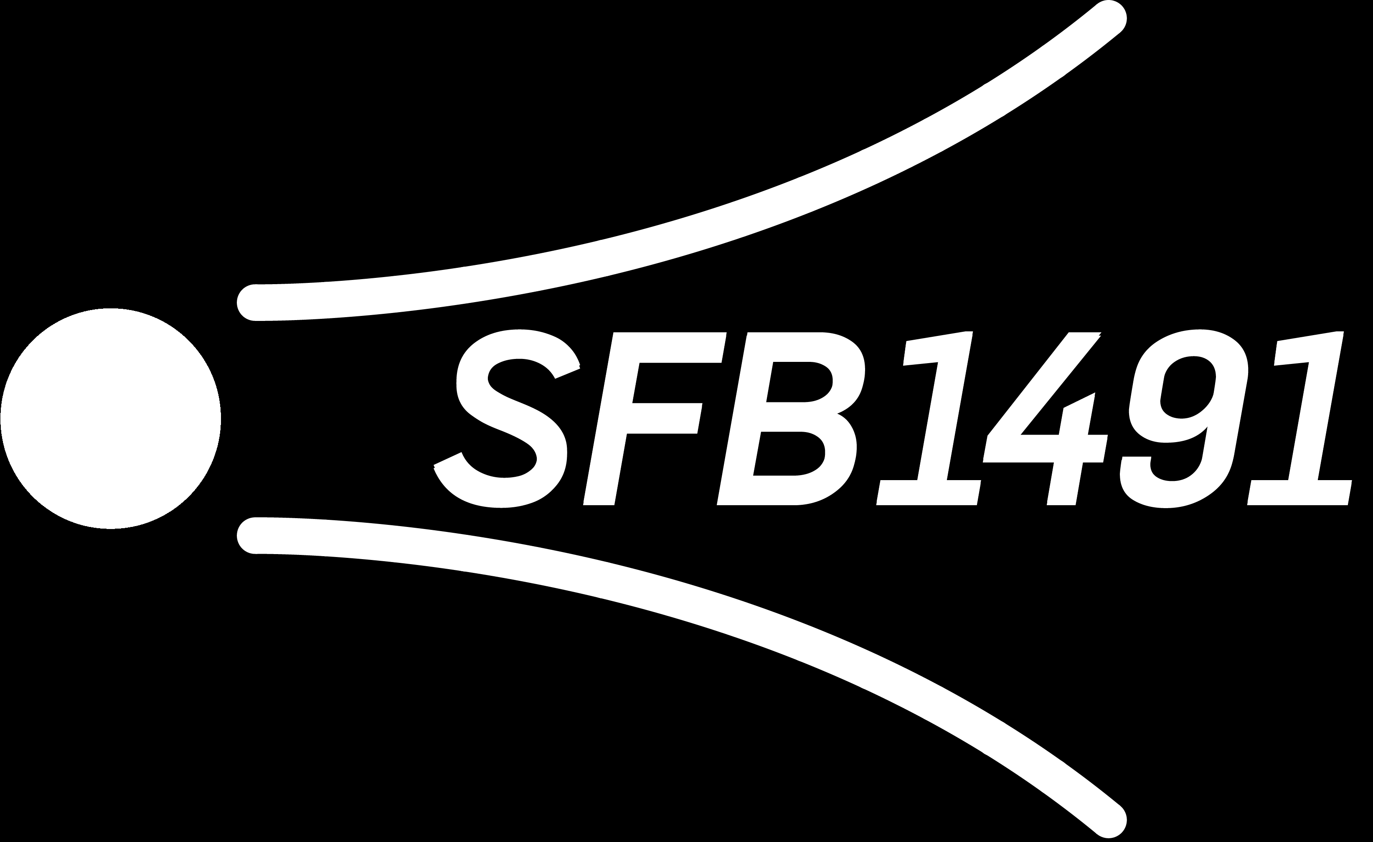
Muon Flux Unfolding: WG Review and Unblinding Plan Pascal Gutjahr
April 11, 2025
WG reviewer: Dennis Soldin
Technical reviewer: Karolin Hymon
Wiki: prompt wiki
Last update: CR call February 7
CR-Call
Source: NASA

Slide 2

Analysis Goals: Detect Prompt Muons
Unfold a muon energy spectrum at surface
Measure prompt component of the atmospheric muon flux
Most energetic muon in bundle
Muon parent:
pion or kaon
yes
no
conventional
prompt
Definition leading muon:
most energetic muon of a muon bundle
Credit: Ludwig Neste

Slide 3
Overview
Analysis
Simulation
Reconstruction
Selection
Forward fit
Run as post
unblinding check
Dataset
CORSIKA 77500 Ehist
SIBYLL 2.3d
10 TeV – 100 EeV
DNN reconstructions
Muon energies
Muon direction
Track geometry
Level 3
L2 muon filter
500 TeV bundle energy cut at surface
Add labels
Fit prompt normalization
Poisson LLH fit
ICRC unblinding
deadline:
May 1st
Validation
Tag prompt / conv particles
MCEq comparisons
Unfolding
Level 4
Add DNN reconstructions
Muon spectrum
Unfold muon flux
Level 5
Data-MC quality cuts

Slide 4
Unblinding Roadmap
Unblind unfolding of the atmospheric muon flux for ICRC → unblinding request deadline May 1st
CRWG review → today
Technical review → next 2 weeks
Collaboration review → until May 1st
ICRC proceedings with unfolded muon flux
Run forward fit as post-unblinding check → unblind in summer
About 1-2 months behind
Method is fundamentally different from unfolding → blindness not violated
Journal paper proposal: includes both the unfolded muon flux and the normalization fit
finish first draft in Autumn
PhD deadline: July
Leander Flottau is working on forward fit
I’ll stay in academia → finish analysis

Slide 5
CRWG Review
Main questions are addressed here,
the rest is explained in the Q&A

Slide 6
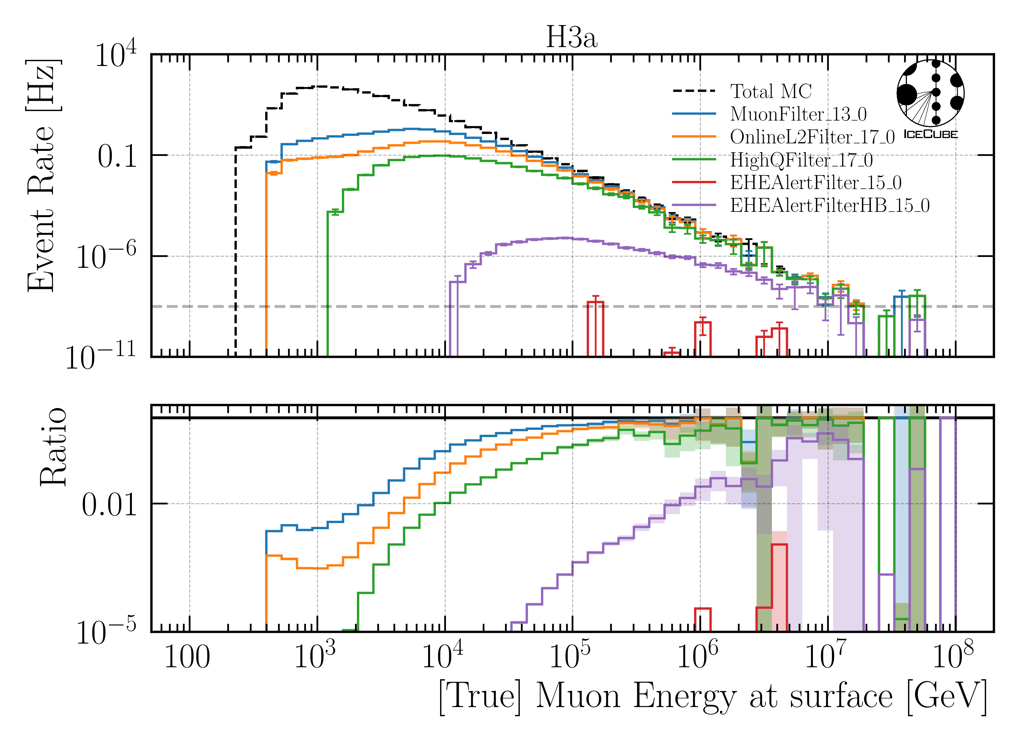
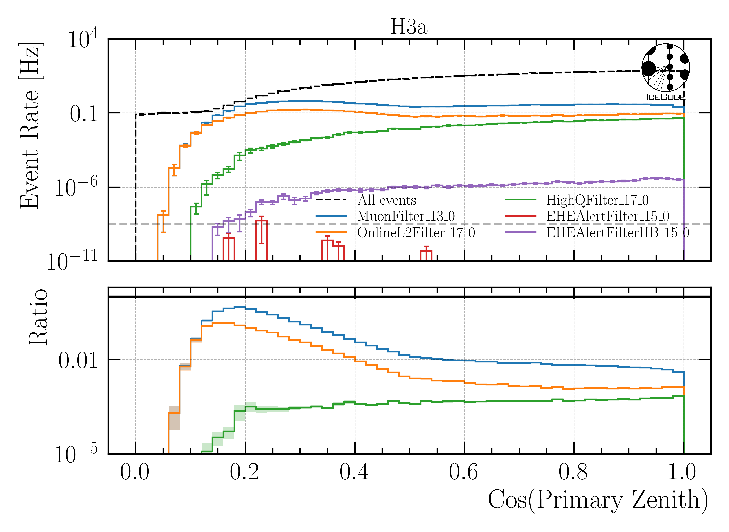
Q: Why do you choose the muon filter?
HighQFilter: removes more horizontal events → muons travel large distances, not enough energy left to pass high-charge filter
Goal: keep AMAP high-energy events at surface → muon filter

Slide 7
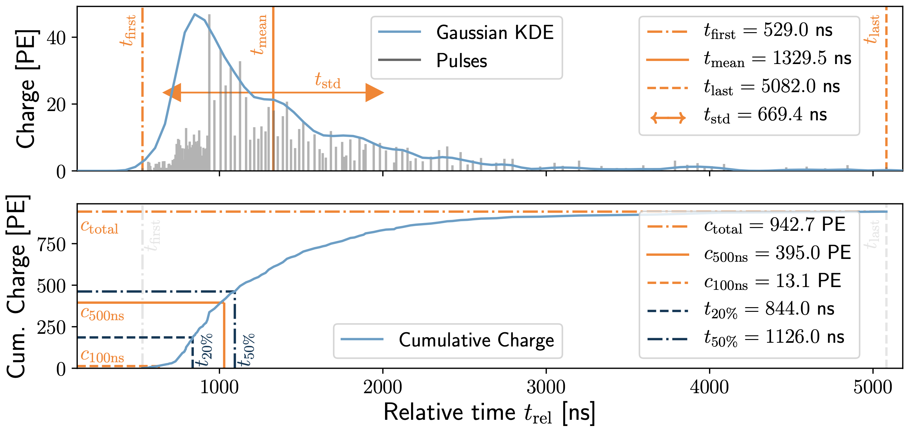
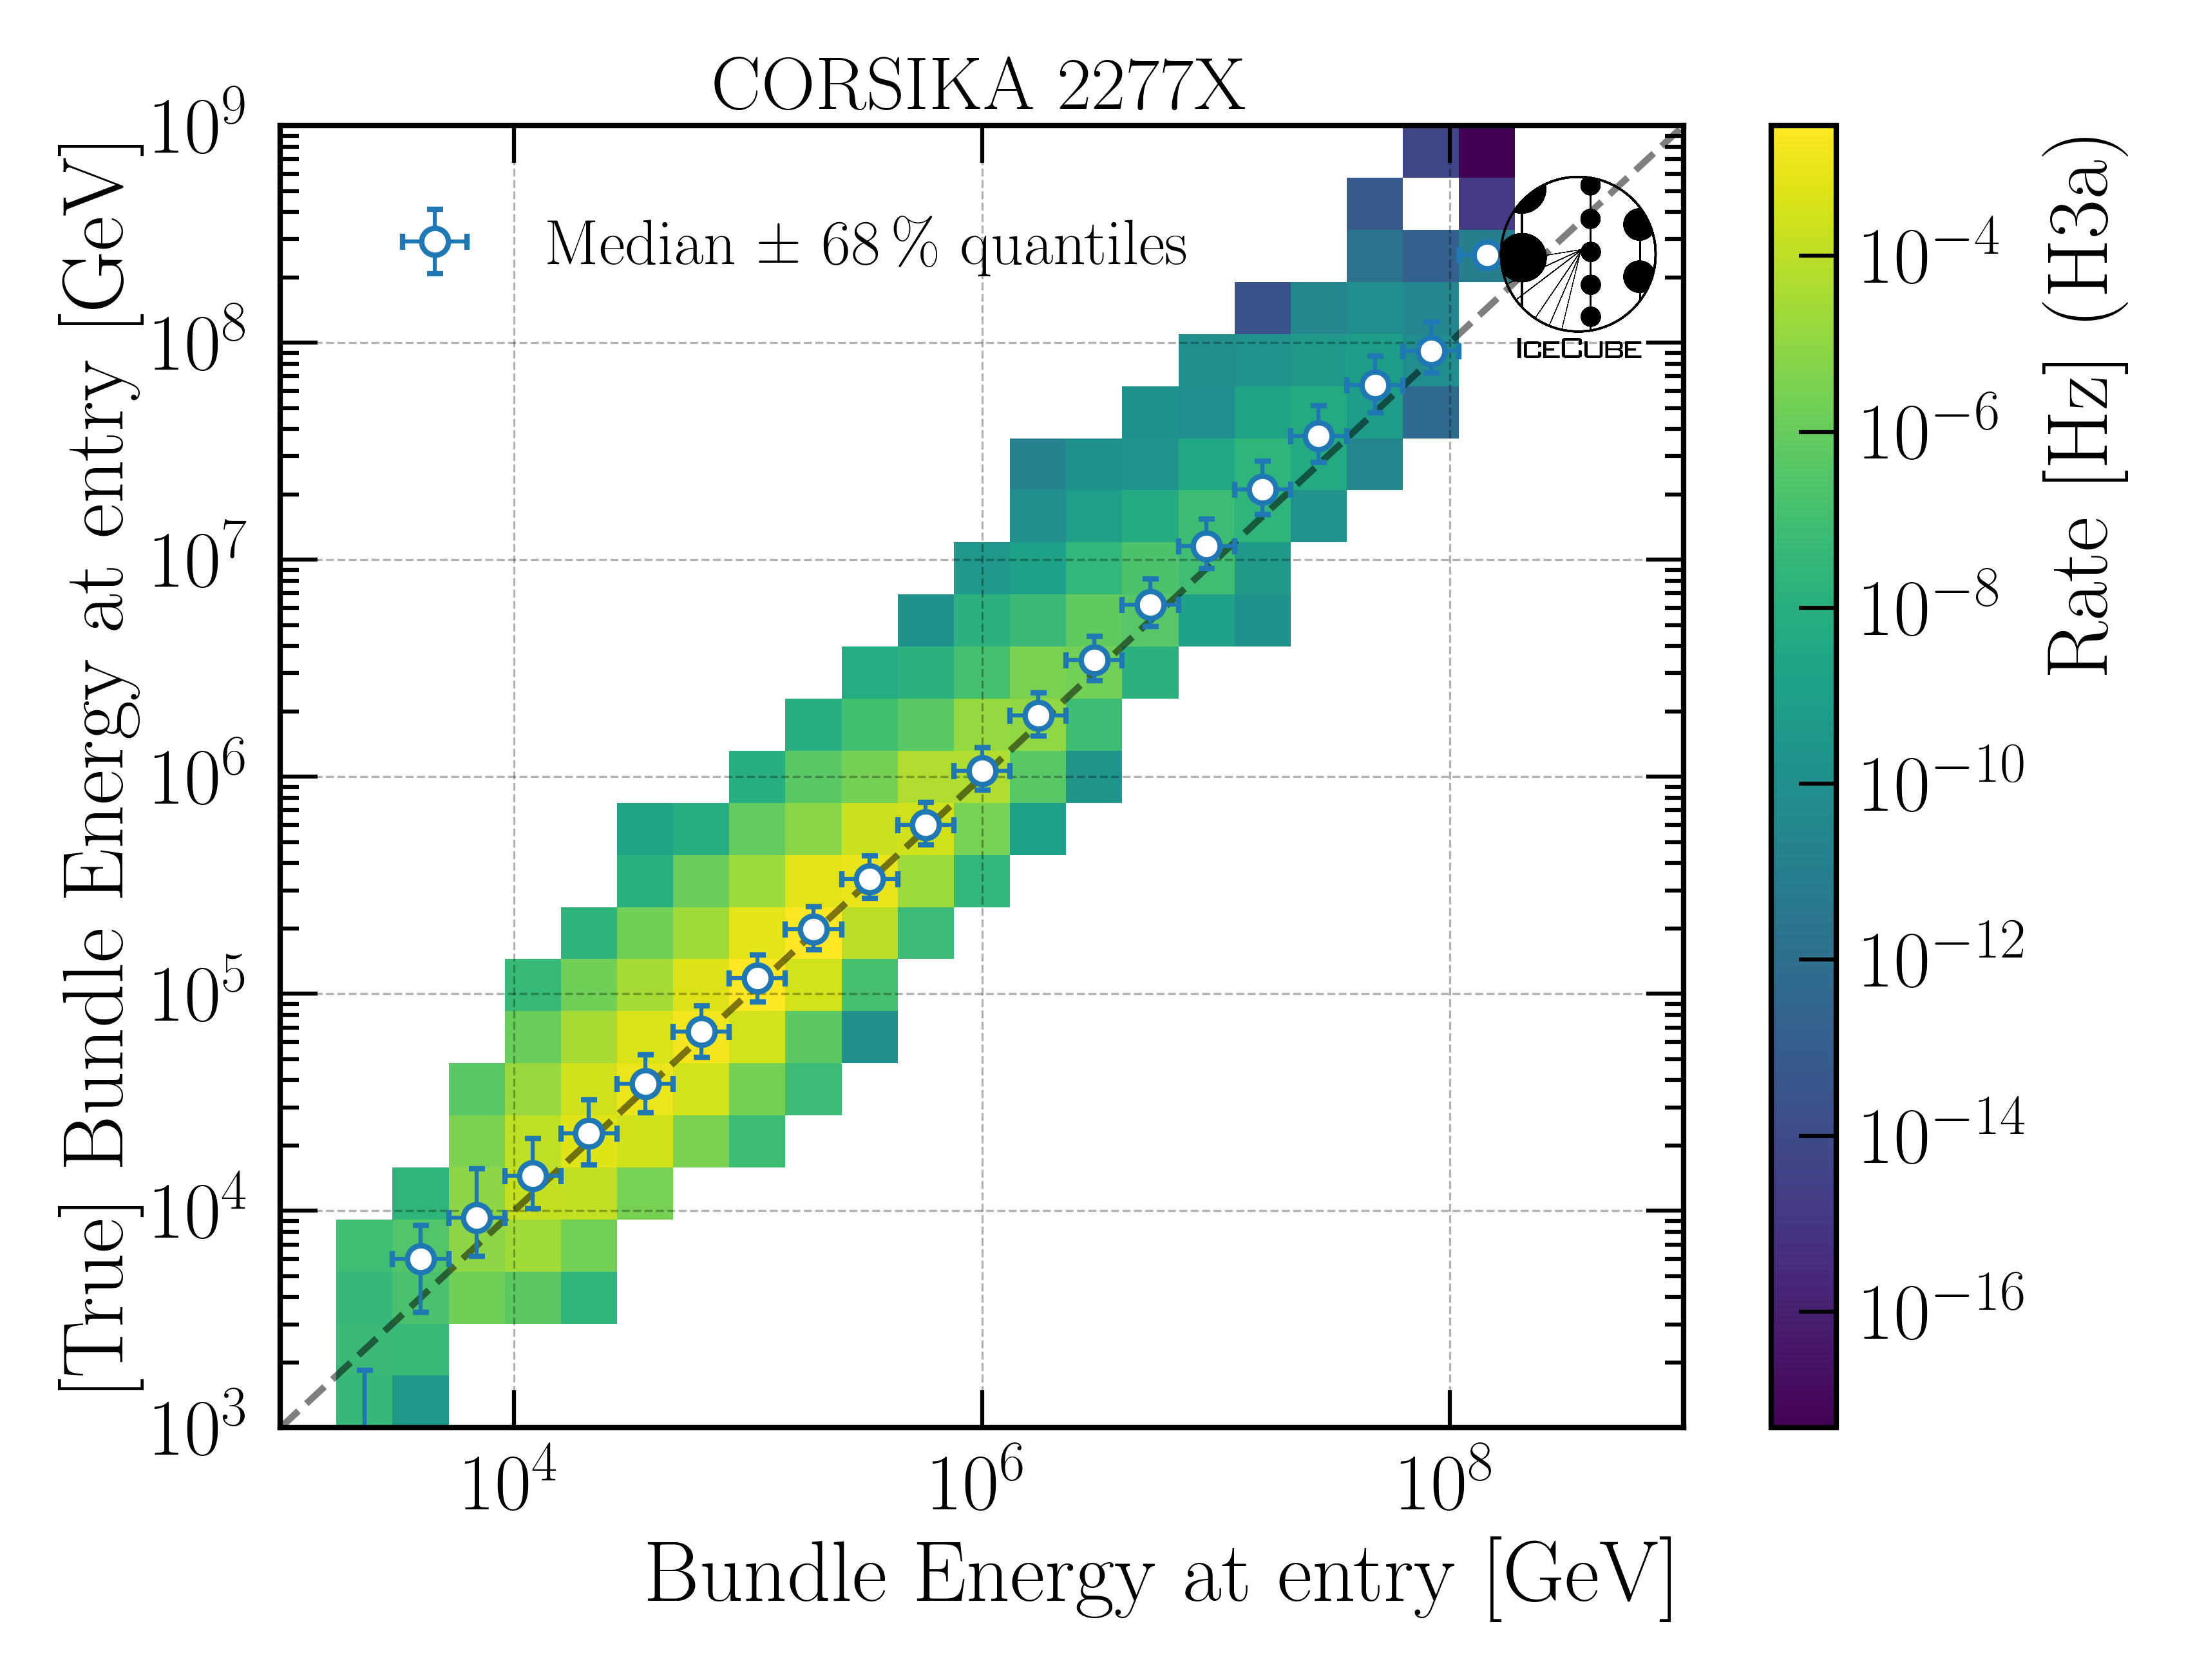
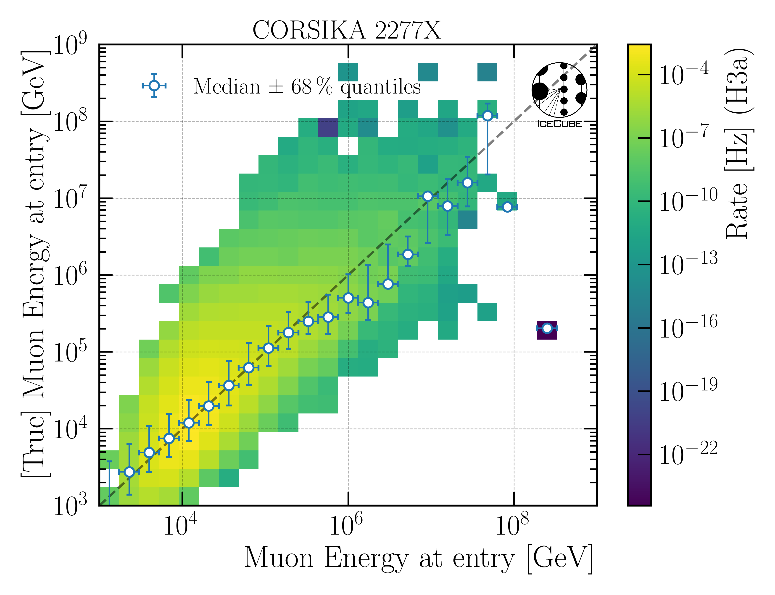
Q: Which quantities do you reconstruct and how do you do this?
10.1088/1748-0221/16/07/P07041
Energy
Bundle energy at entry / surface
Leading muon energy at entry / surface
Direction
Zenith / azimuth of leading muon
Geometry
Propagation length
Entry point
dnn_reco framework (Mirco Hünnefeld)
Low-level features based on charge and timer per DOM

Slide 8
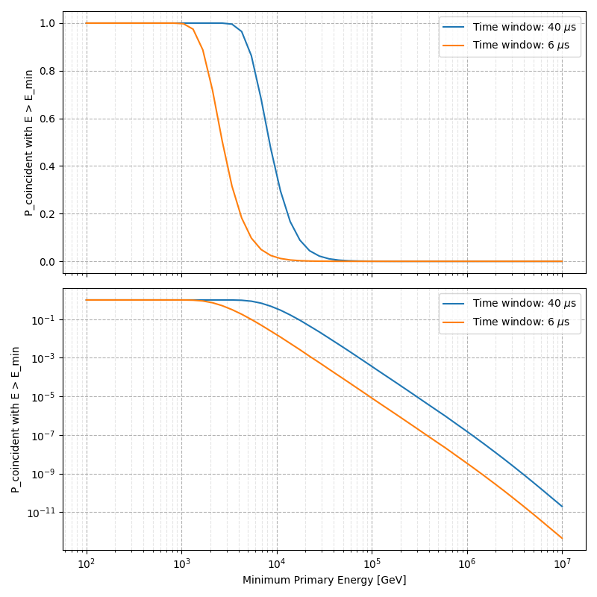
Q: Coincident events are not simulated. Can you show that this does not cause any problems?
For primary energies above 10 TeV, using a time window of 6 µs, the chance for a coincident event is ≤ 1 %
Apply time-window cleaning of 6 µs to pulses
Linear scale
Log scale

Slide 9
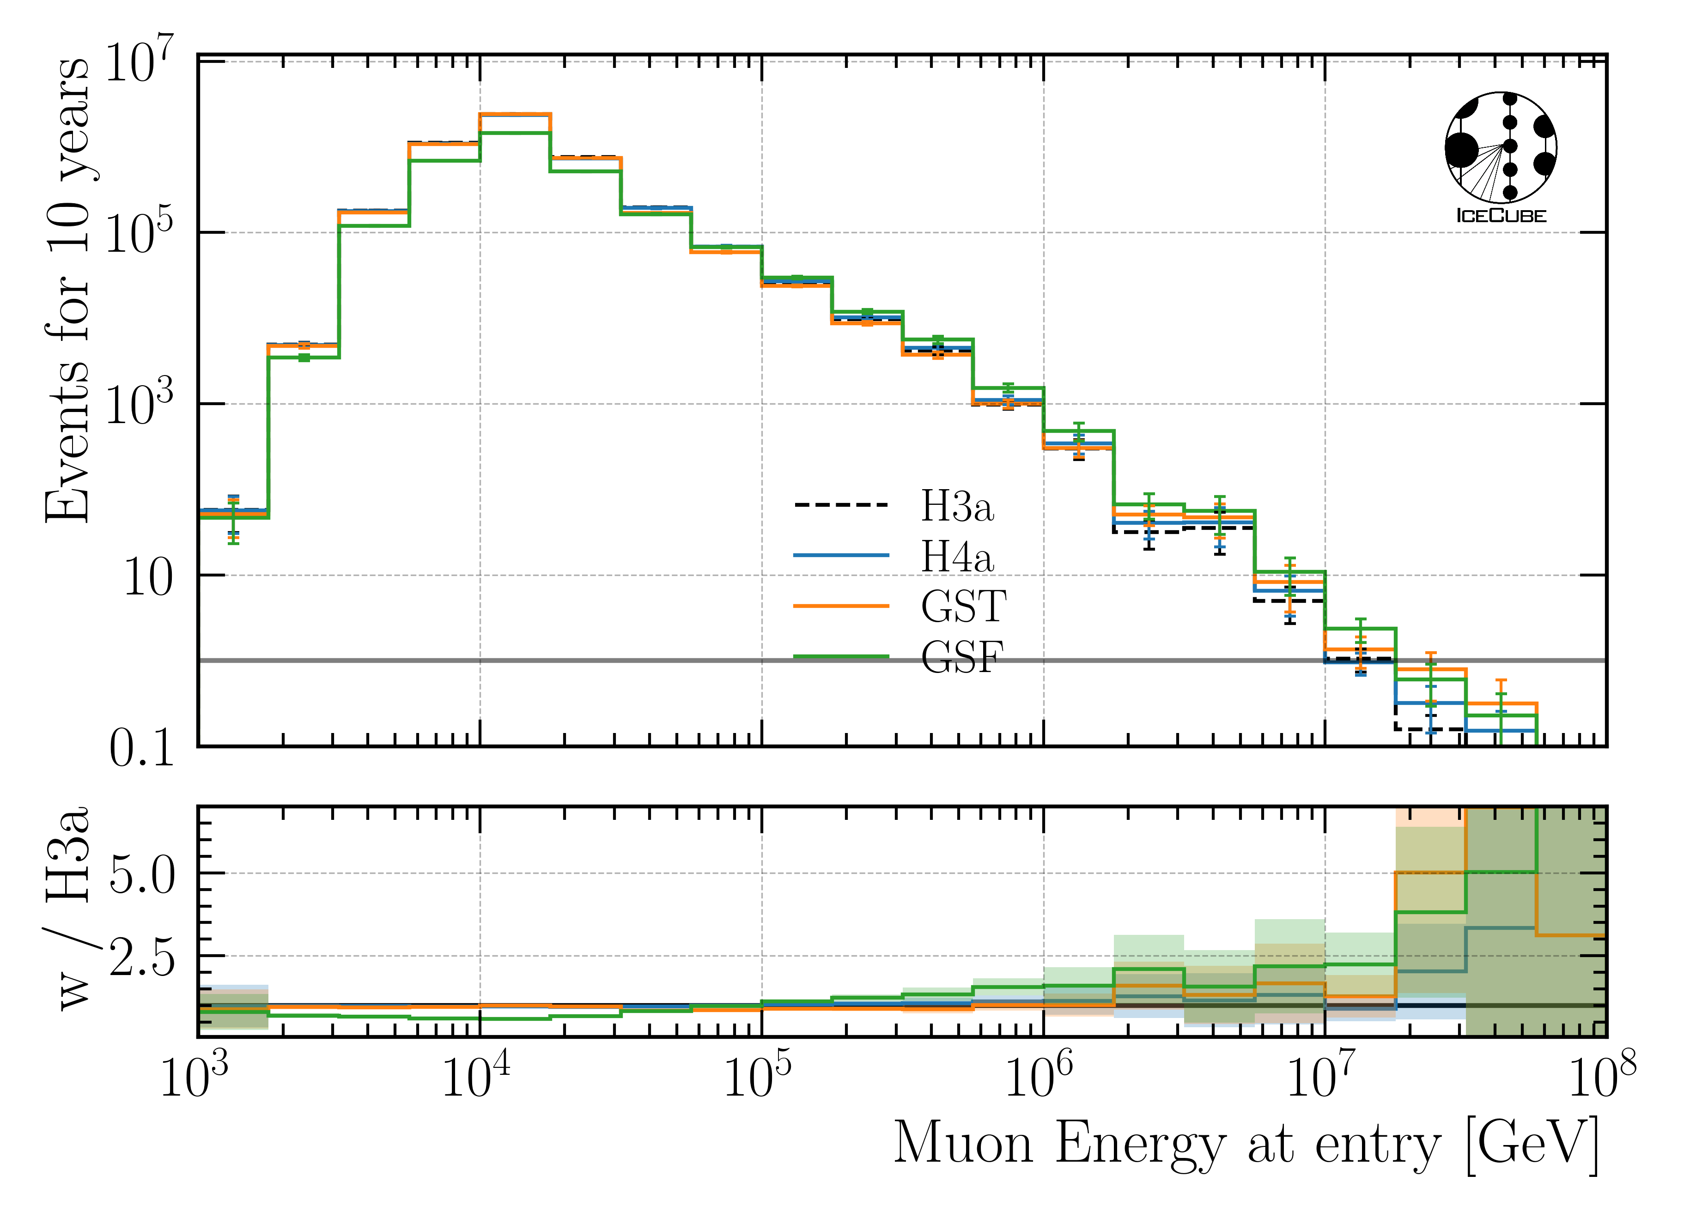
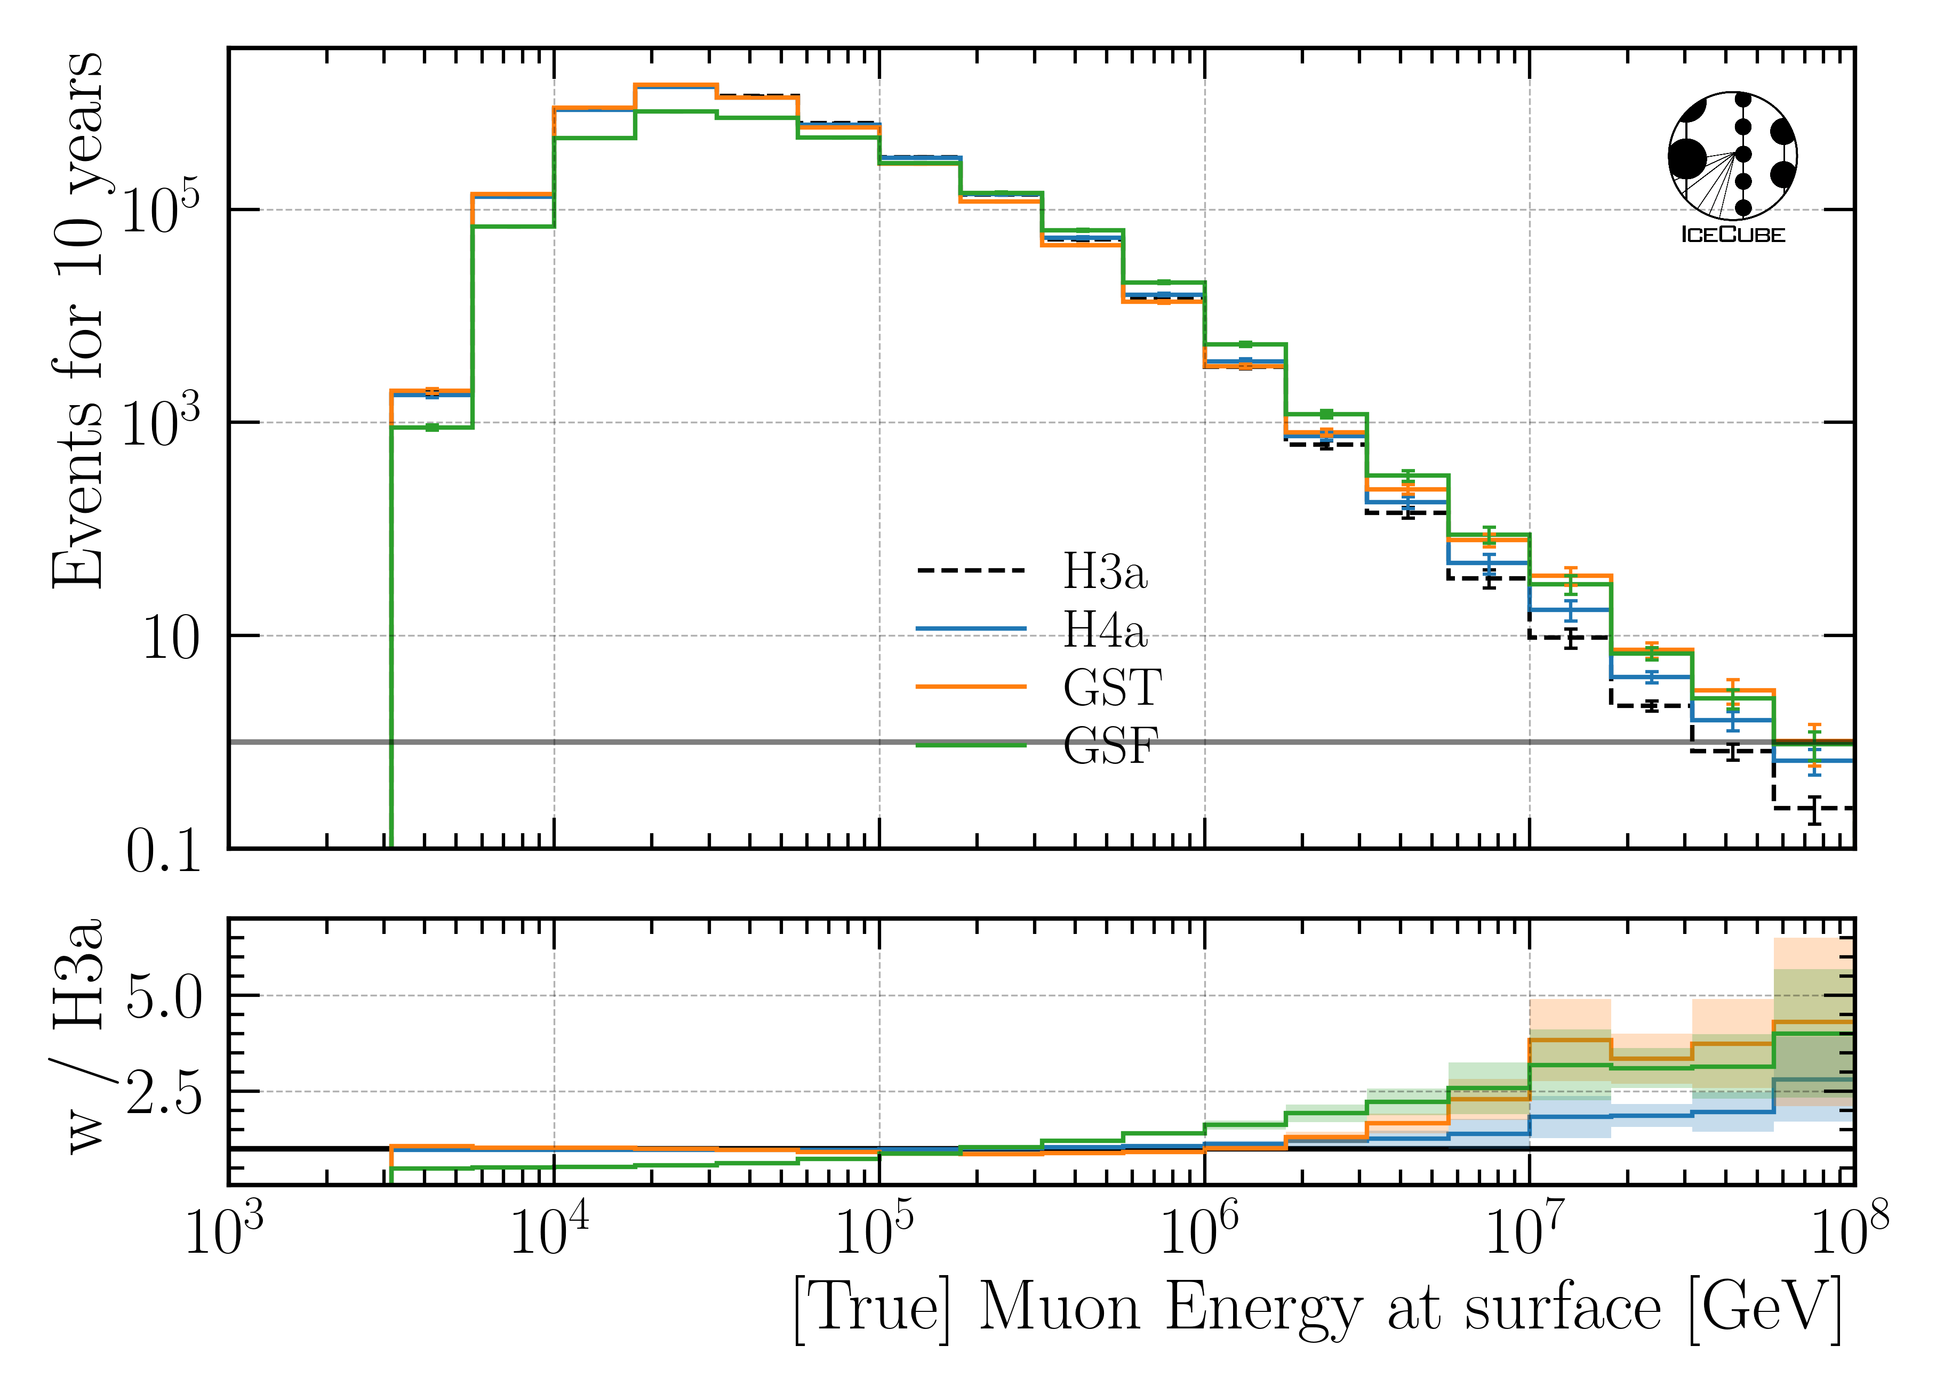
Q: What is the impact of the primary flux on your (most important) distributions?
Primary models diverge towards higher energies

Slide 10
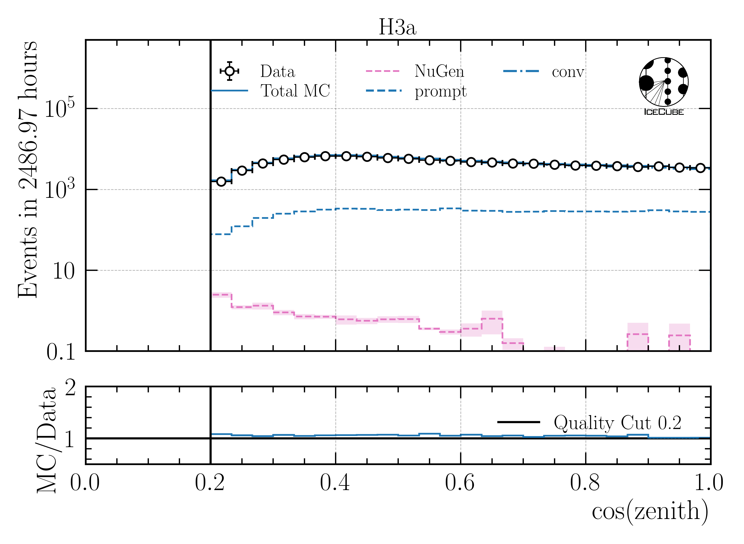
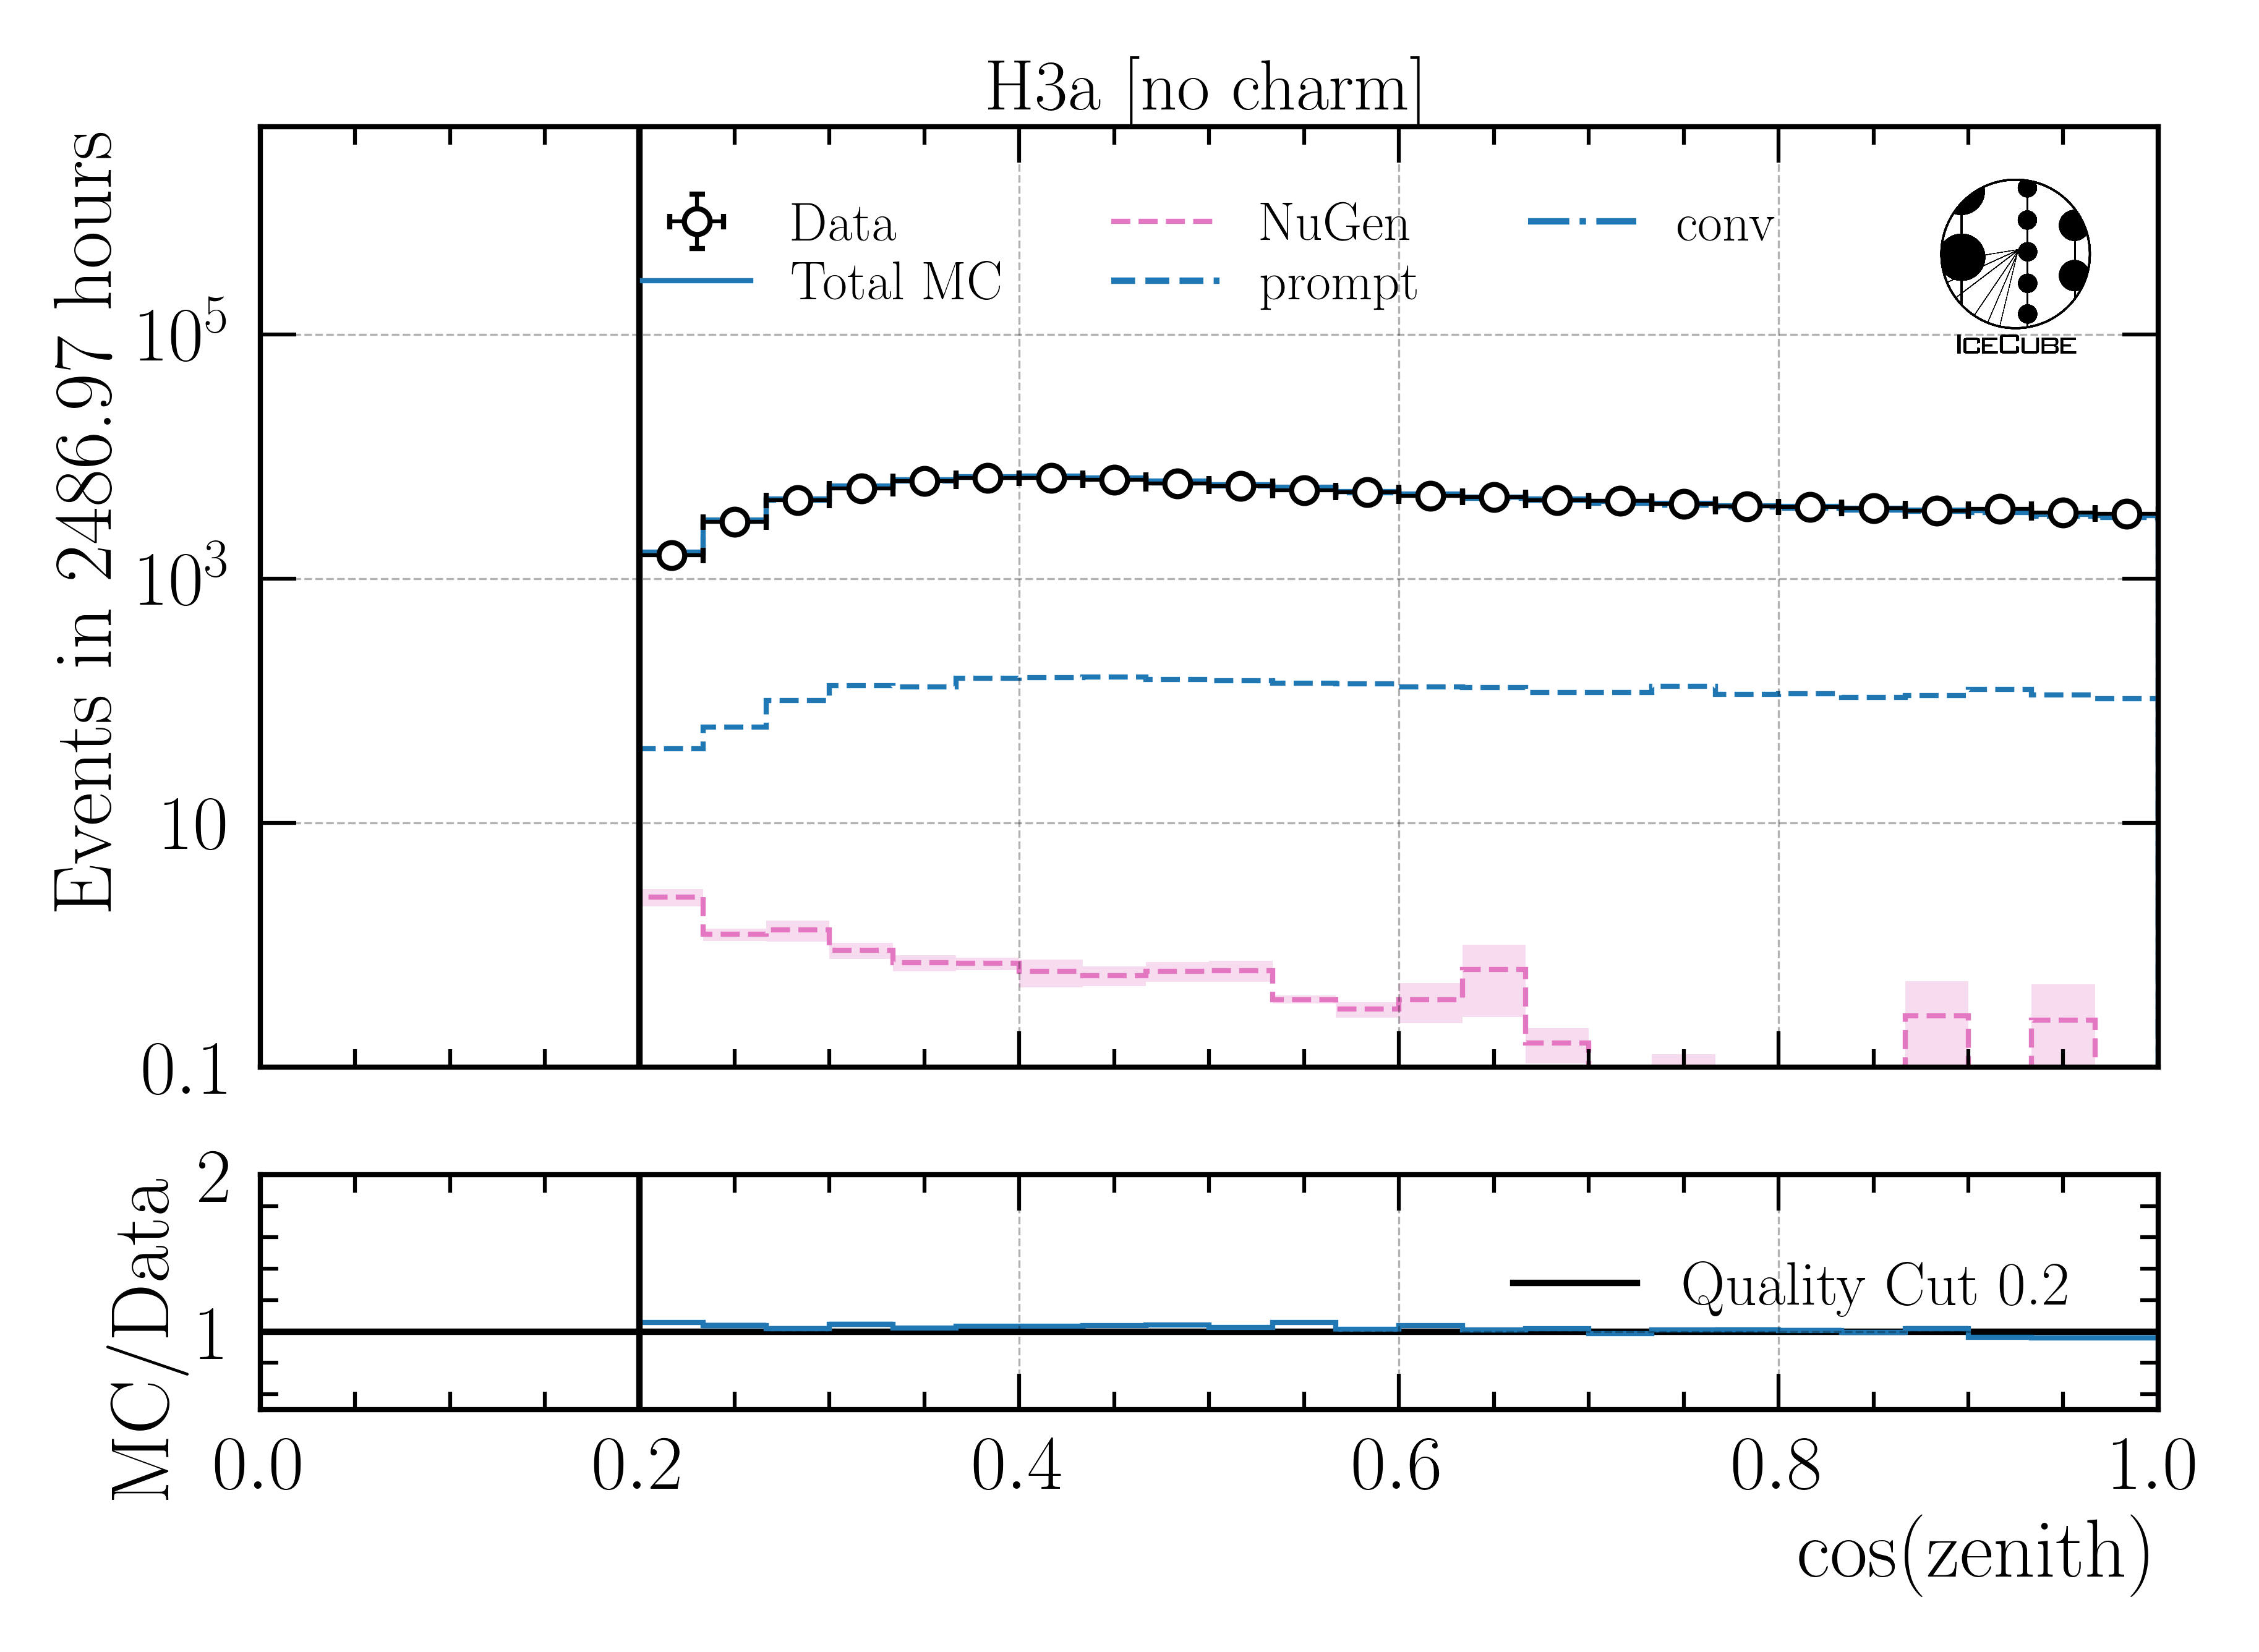
Q: Can you show a zenith distribution with prompt and conv?
conv
Conv dominates entire distribution by 1-2 orders of magnitude
Charm has no impact

Slide 11
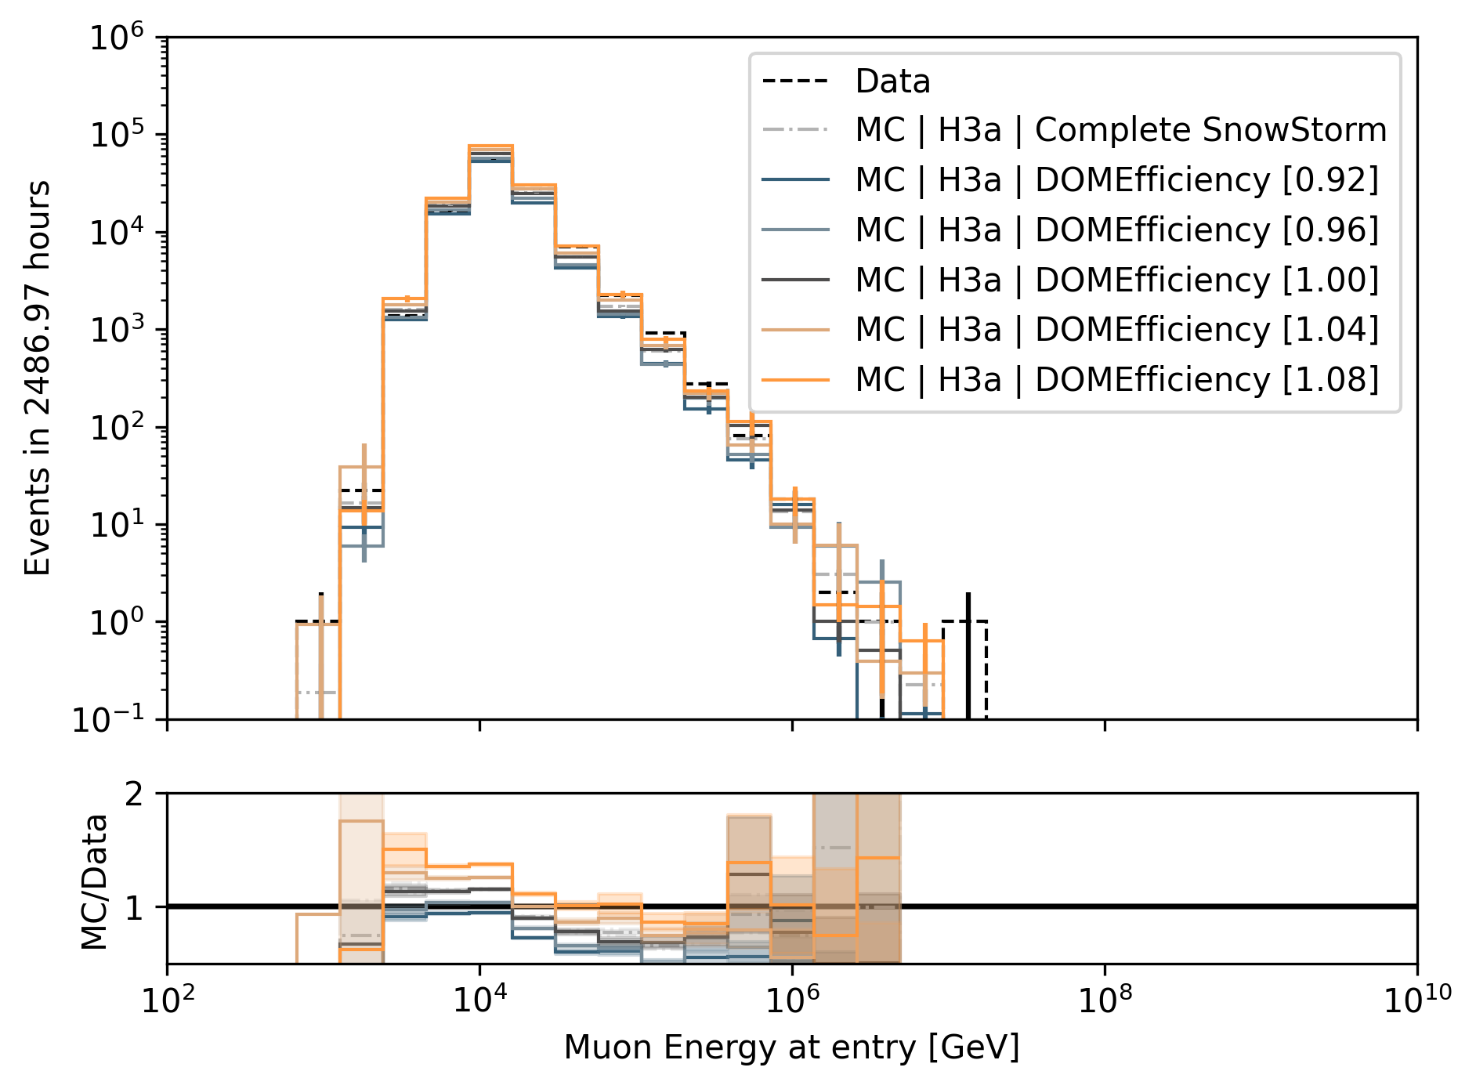
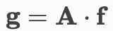
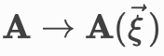
Q: How do you treat systematics? → here for unfolding
Explained in the wiki here
Ice systematics – Snowstorm
Vary ice properties
Relative change of bin content
Fit as nuisance parameter
Cosmic ray primary flux models
Build matrix for different primary models and show that the result is independent of the input model
Hadronic interaction models
CORSIKA simulations are extensive, we rely on SIBYLL 2.3d (similar to the primary flux, the impact should be negligible)
impact on proxy
parameterization

Slide 12
Conclusion & Outlook
Move forward with unblinding the unfolding for ICRC
Run normalization fit as post-unblinding check
Answered CRWG questions
Finish technical review
Ask for a collaboration reviewer
✅
Thank you for listening. Do you have more questions?

Slide 13
Unfolding

Slide 14
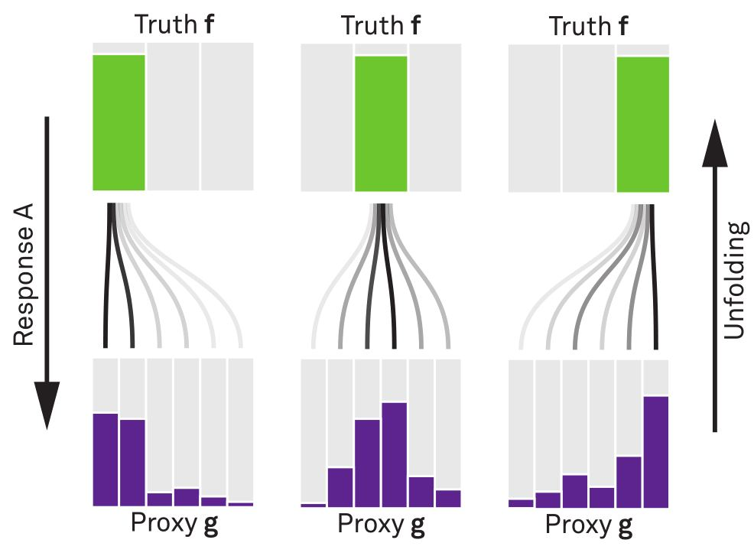


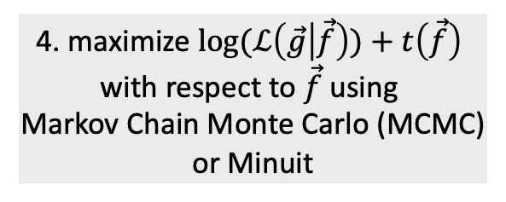
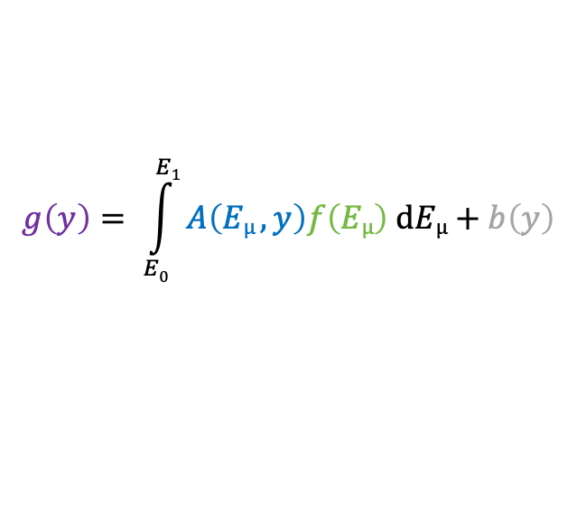
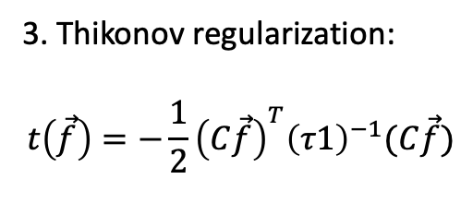
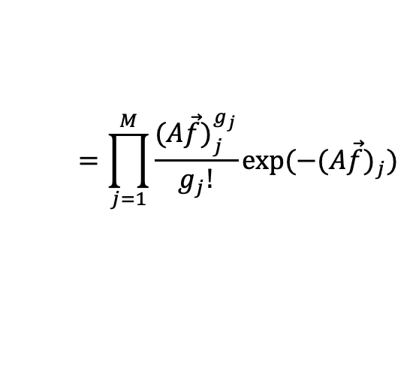
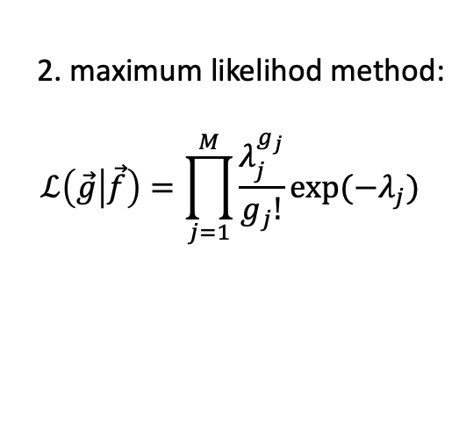
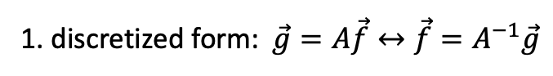
Unfolding in a nutshell
folding
unfolding
1. discretized form: $\vec{g}=A\vec{f}↔\vec{f}=A^{−1}\vec{g}$
measured proxy
detector response
background
$$g\left(y\right)= \int_{E0}^{E1}{A\left(Eµ , y\right)f\left(Eµ\right) dEµ+b\left(y\right) }$$
2. maximum likelihod method:
$$ℒ\left(\vec{g} | \vec{f}\right)=\prod_{j=1}^{M}{\frac{λ_{j}^{g_{j}}}{g_{j}!}exp⁡(−λ_{j})}$$
3. Thikonov regularization:
$$t\left(\vec{f}\right)=−\frac{1}{2}{\left(C\vec{f}\right)}^{T}{\left(τ1\right)}^{−1}(C\vec{f})$$
true energy distribution
$$=\prod_{j=1}^{M}{\frac{{(A\vec{f})}_{j}^{g_{j}}}{g_{j}!}exp⁡(−{(A\vec{f})}_{j})}$$
funfolding
by M. Börner
4. maximize $log⁡(ℒ\left(\vec{g} | \vec{f}\right))+t\left(\vec{f}\right)$
with respect to $\vec{f}$ using
Markov Chain Monte Carlo (MCMC)
or Minuit
Credit: T. Hoinka

Slide 15
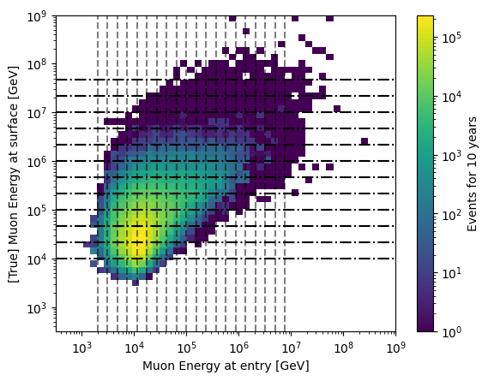
Proxy vs Target

Slide 16
Unfold Event Rate

Slide 17
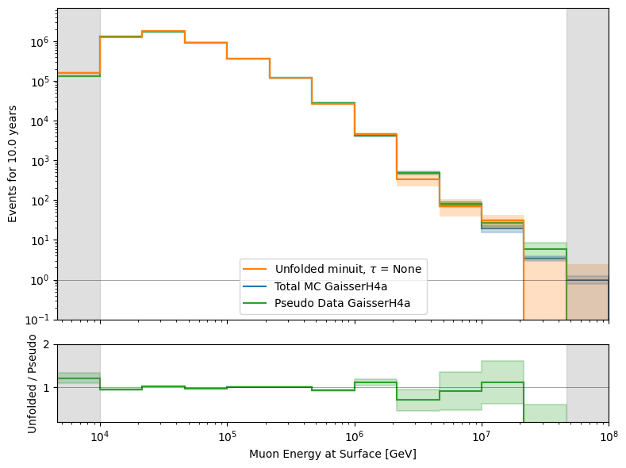
Event Rate

Slide 18
Unfold Muon Flux

Slide 19
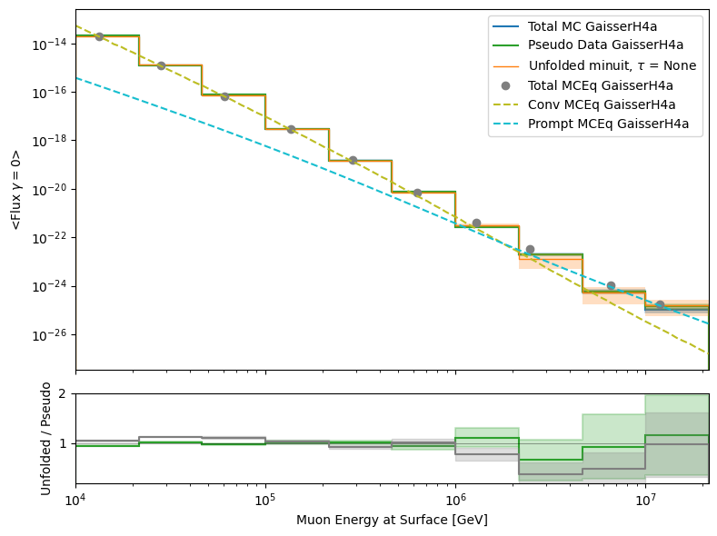
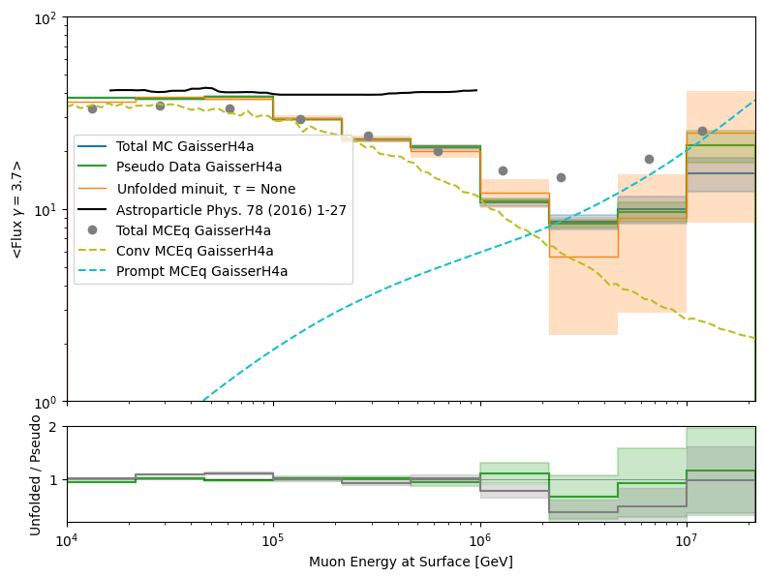
Muon Flux at Surface

Slide 20
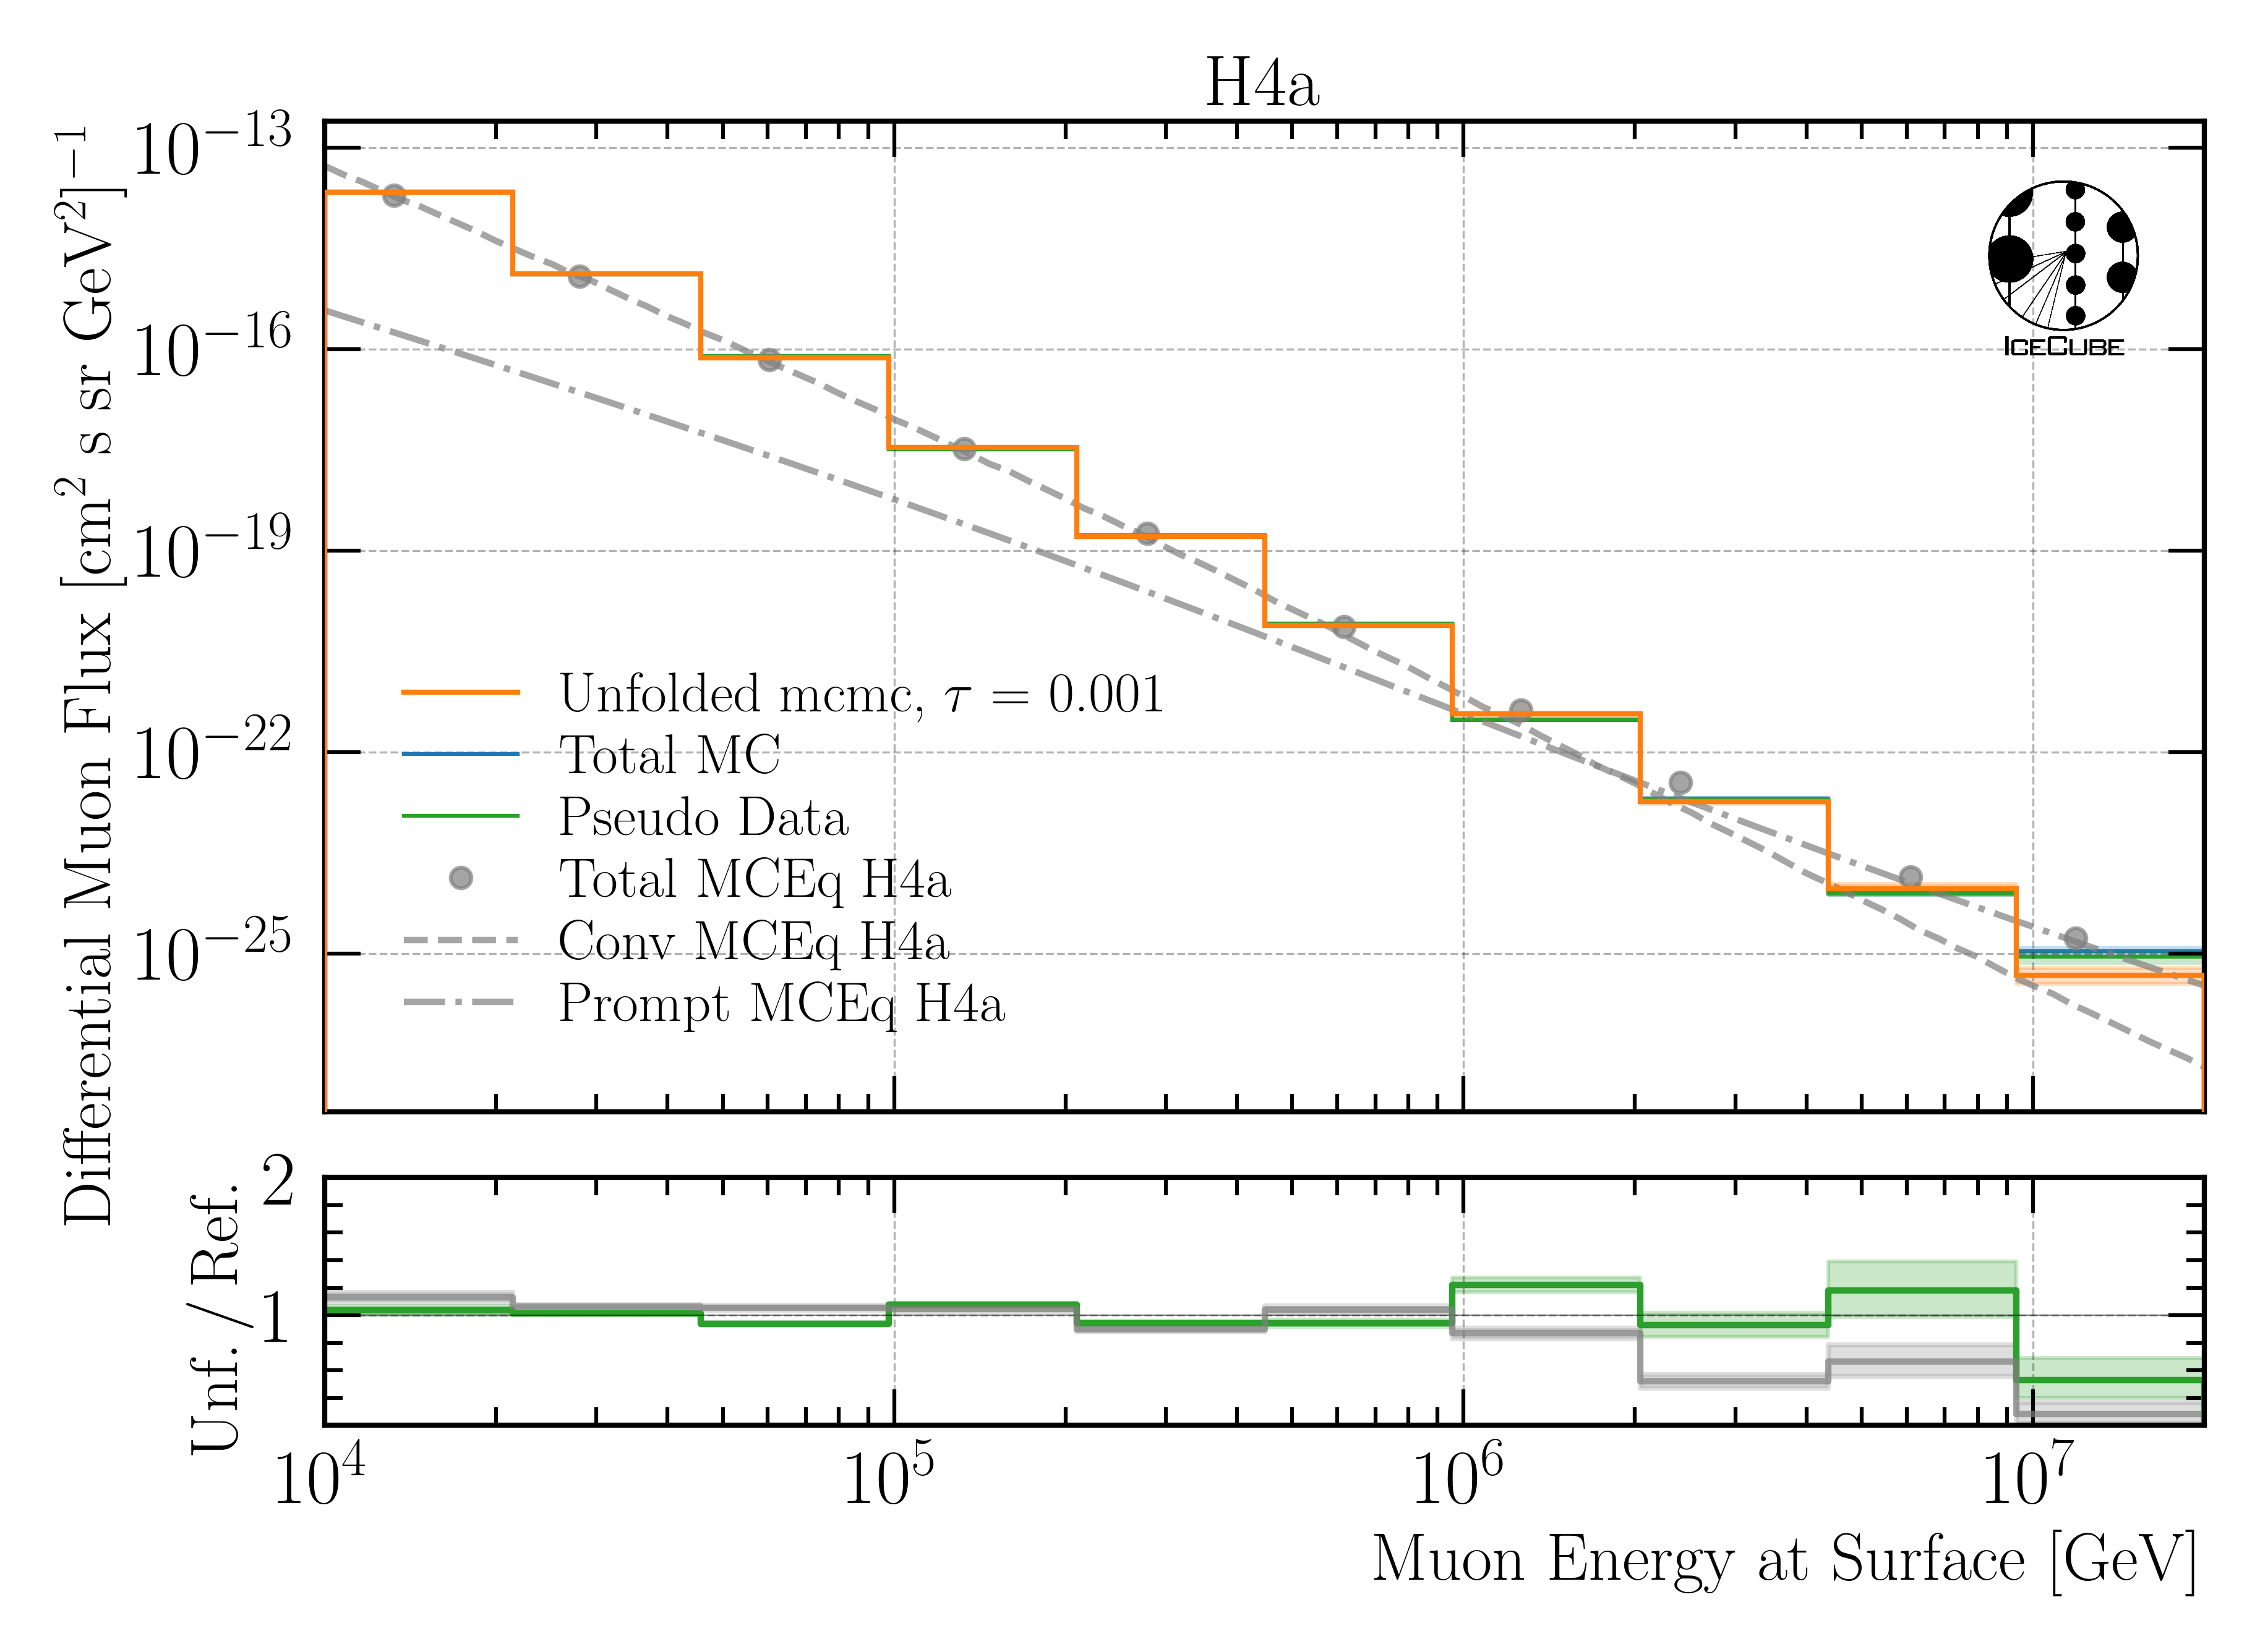

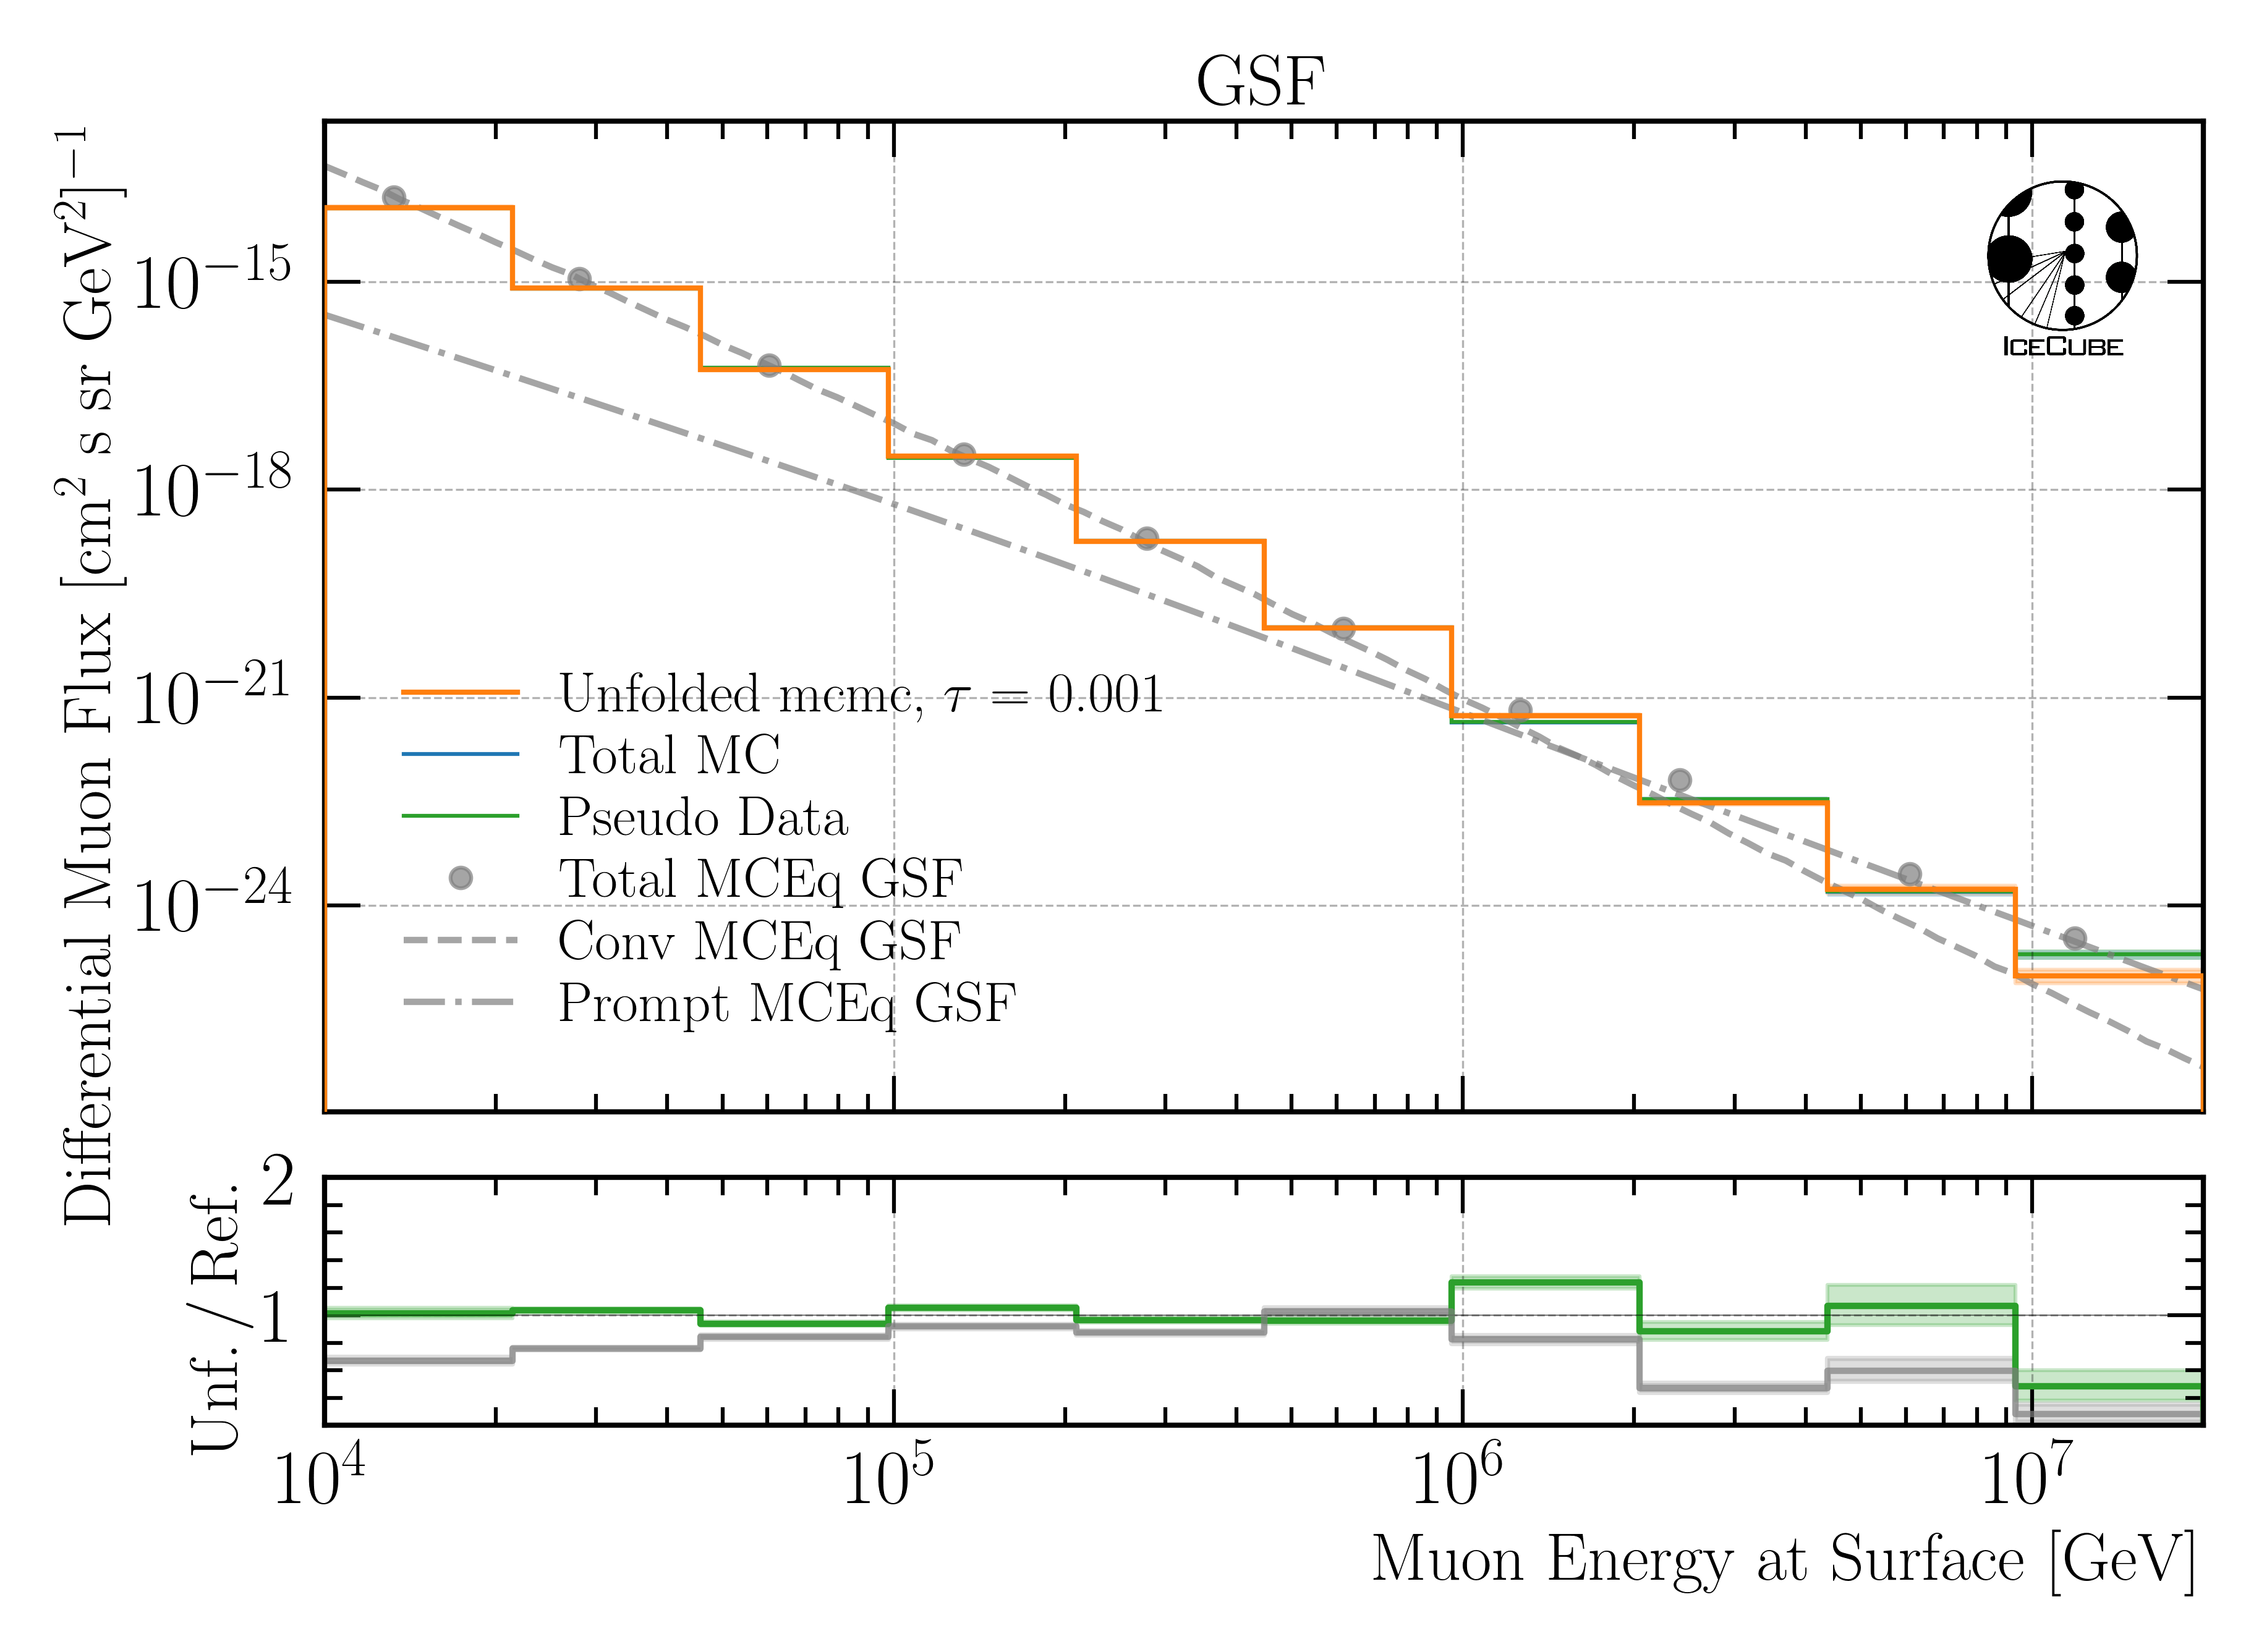
Check impact of primary input model
build model on H4a
unfold H3a, H4a and GSF
green line should align with 1
Unfolding independent of input primary flux model
grey ratio to MCEq depends on the expectation value per bin, here this is calculated based on H4a
→ this leads to minor deviations for H3a and GSF

Slide 21
Ice Systematics
Snowstorm
Scattering
Absorption
DOMEfficiency
Hole Ice Forward p0
Hole Ice Forward p1

Slide 22
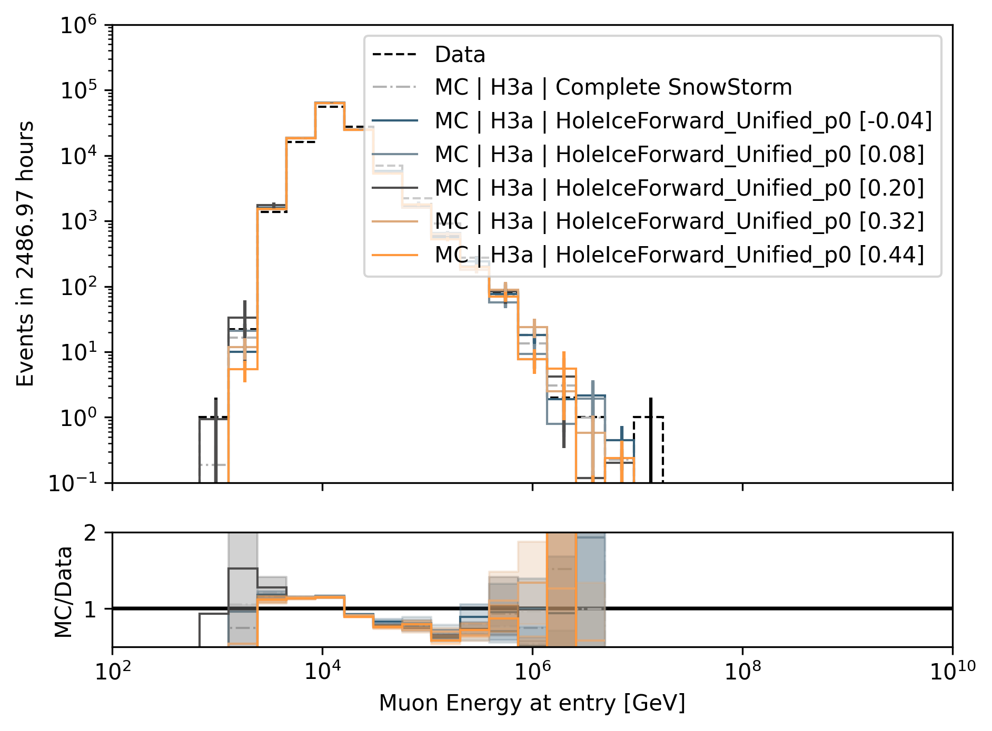
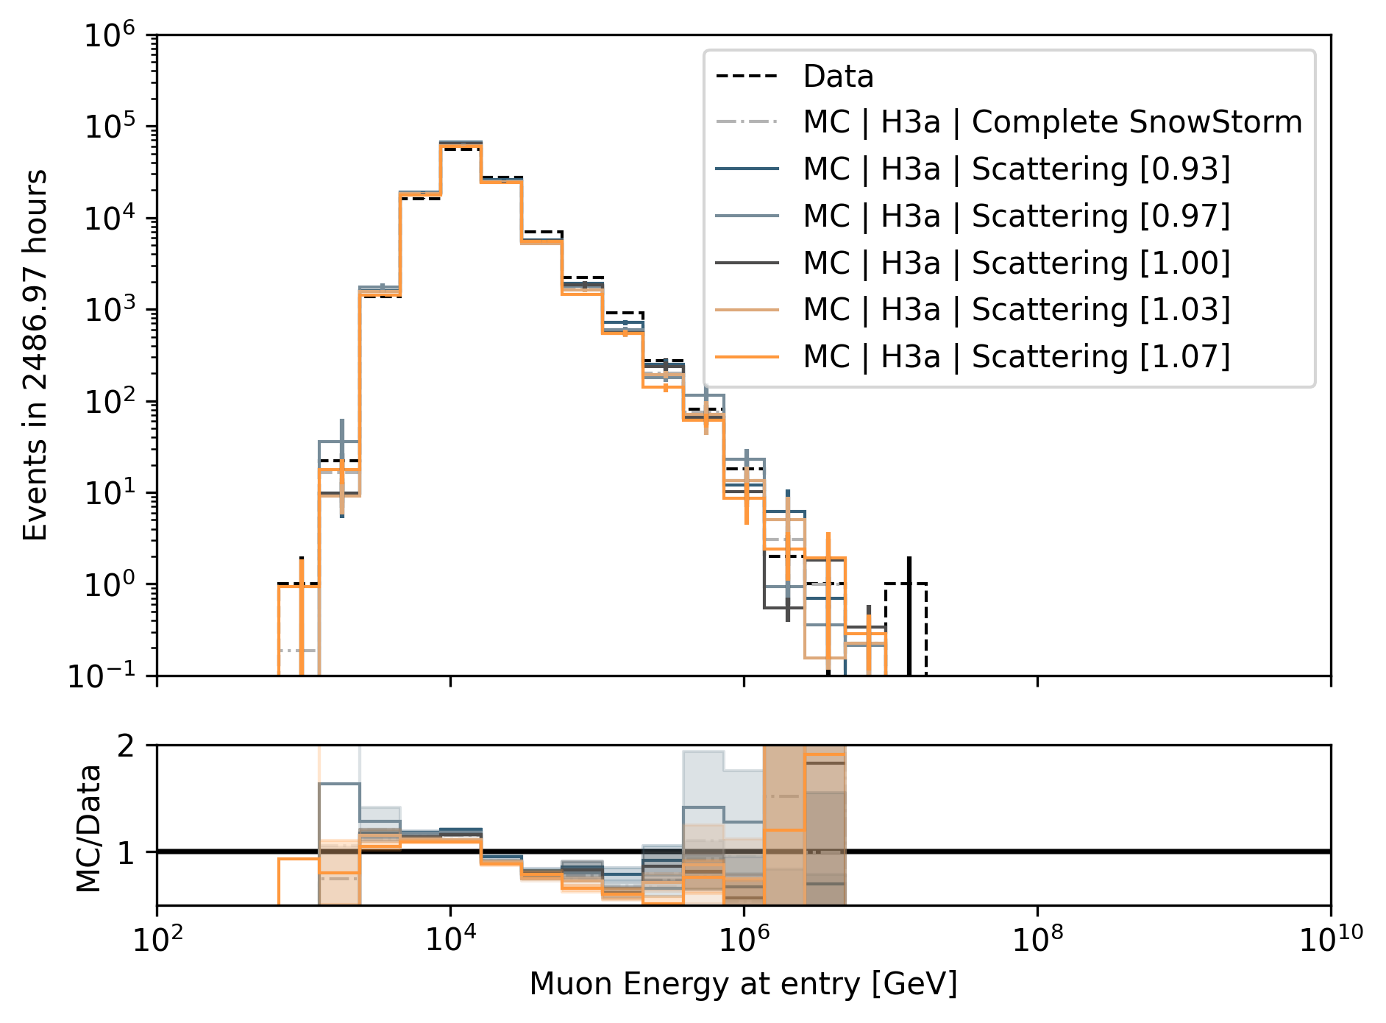
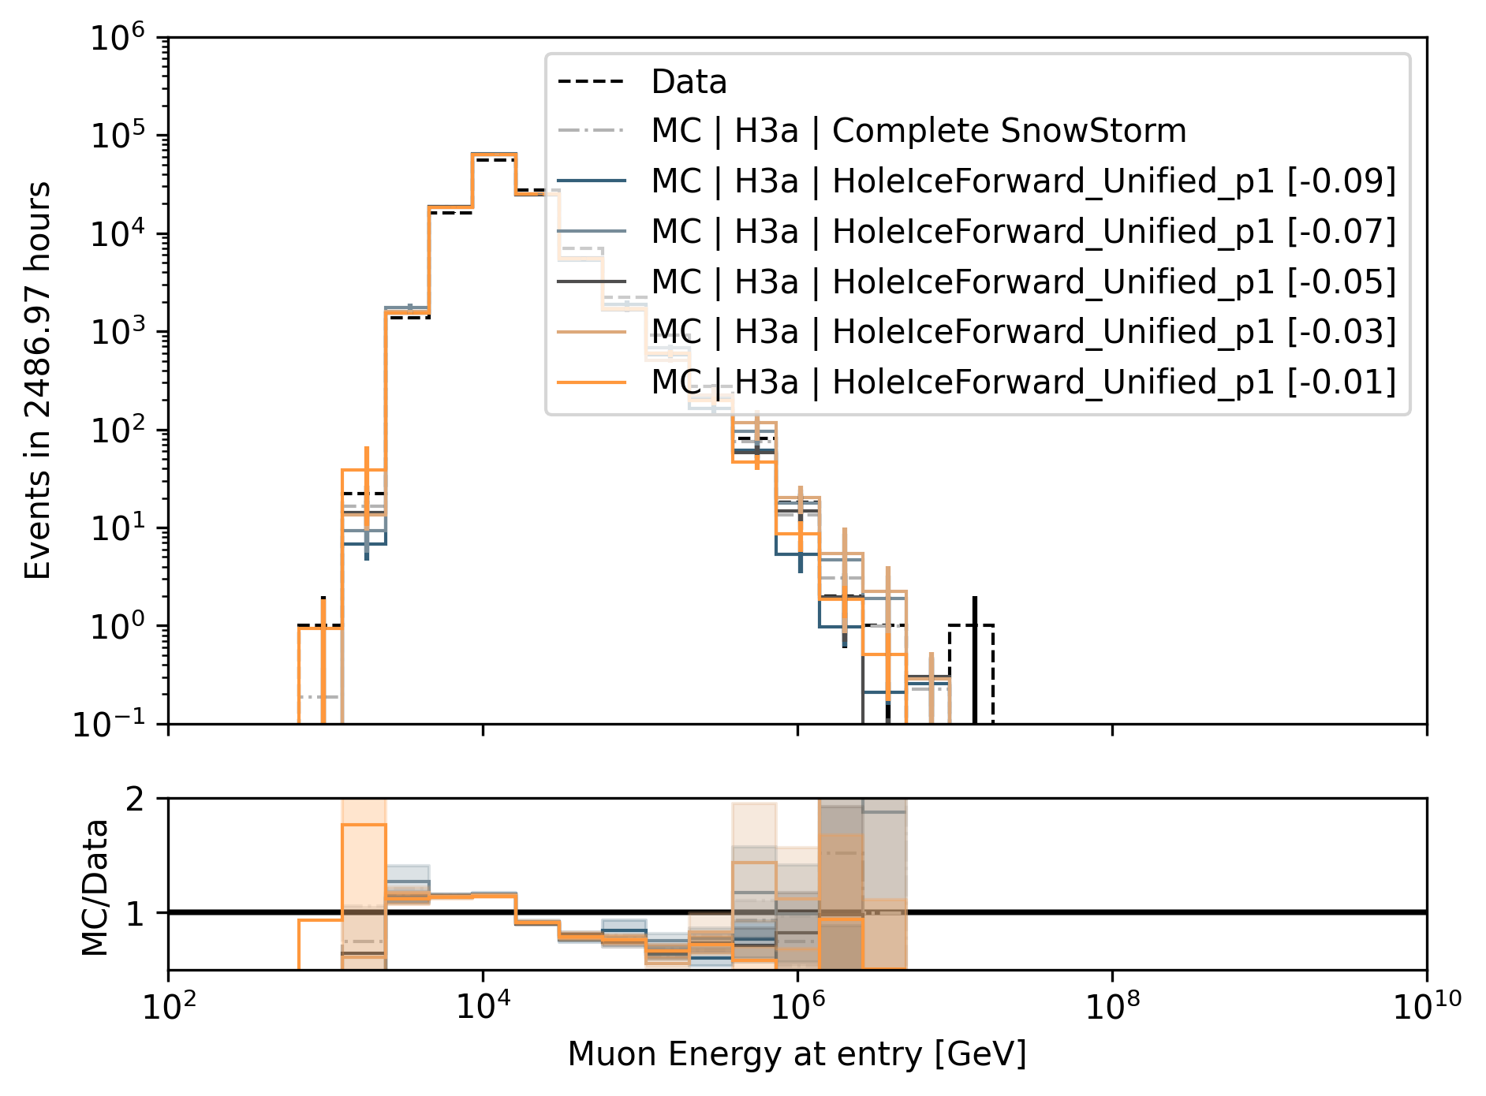
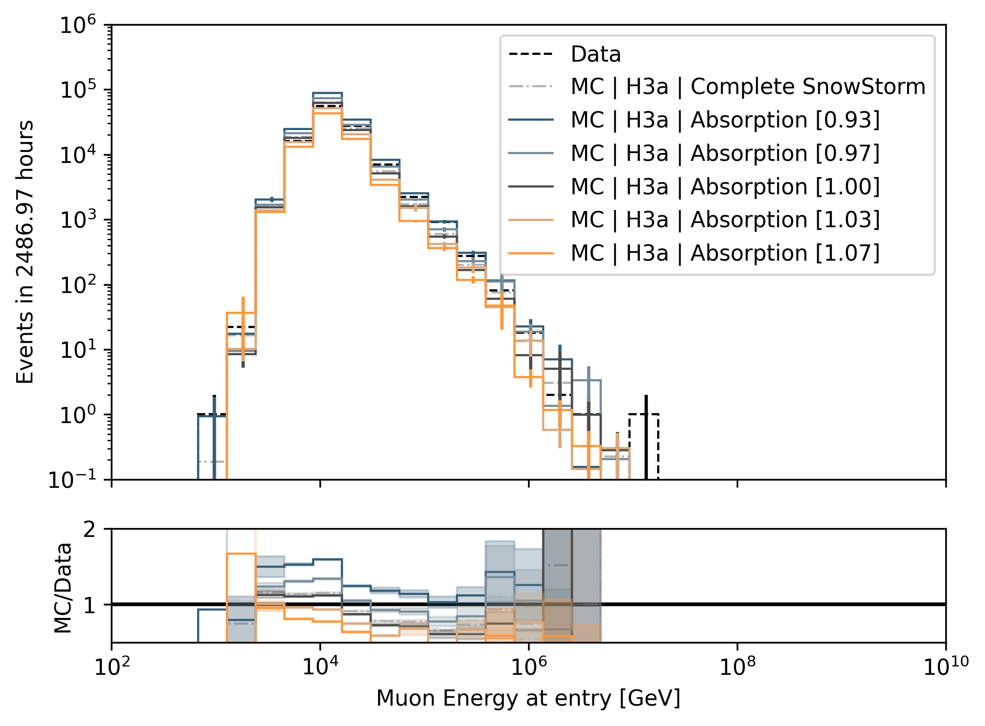
Systematics Impact on Muon Energy at Entry (Proxy)
HoleIce p0
Scattering
HoleIce p1
Divide systematic range into 5 equidistant bins
Largest impact by DOMEfficiency and Absorption
DOMEfficiency
Absorption

Slide 23
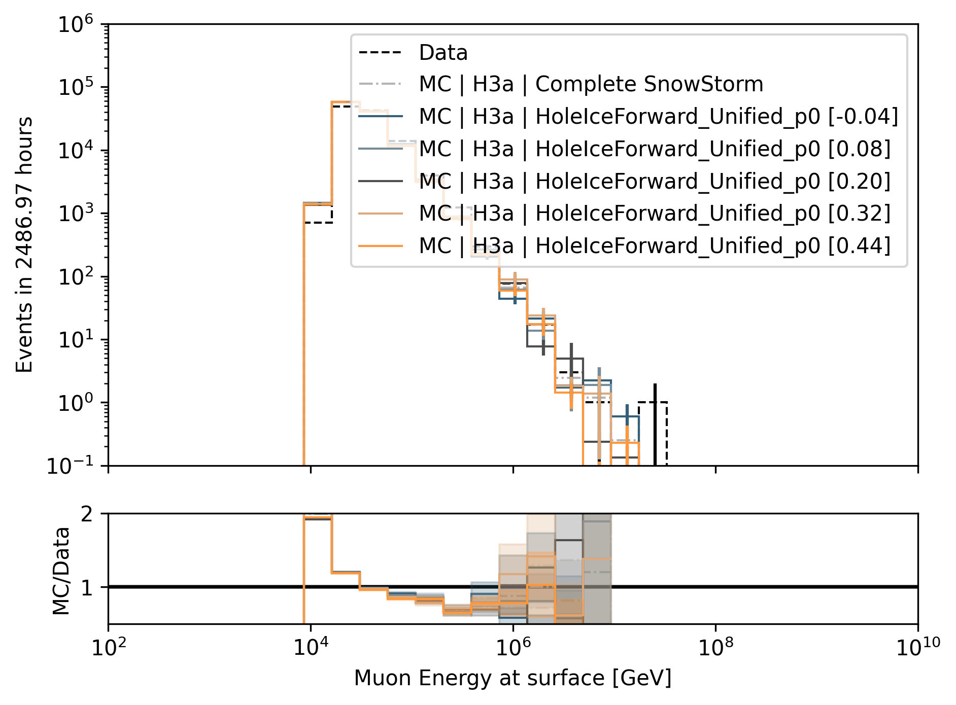
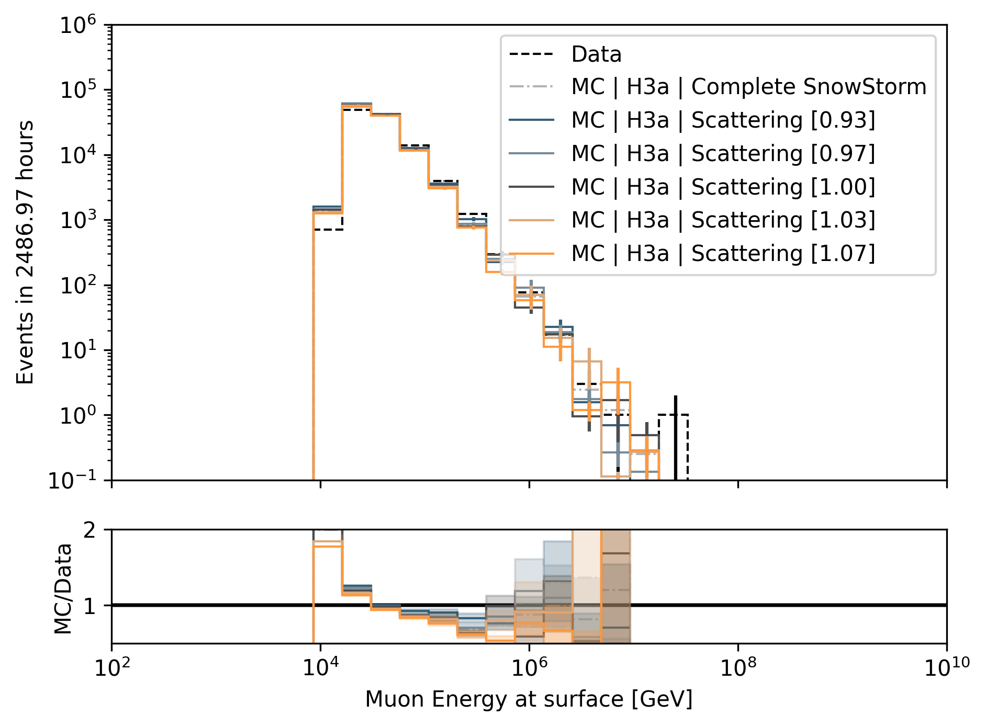
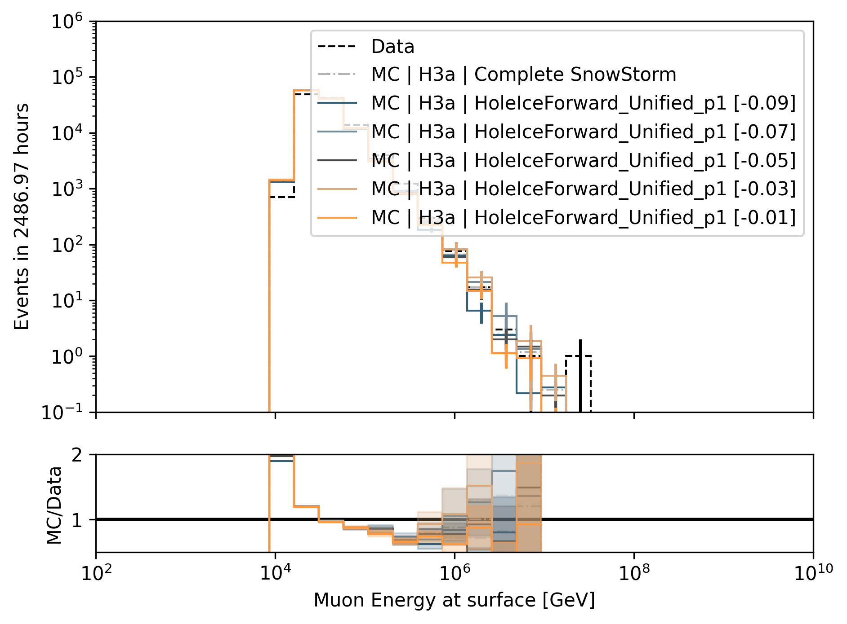
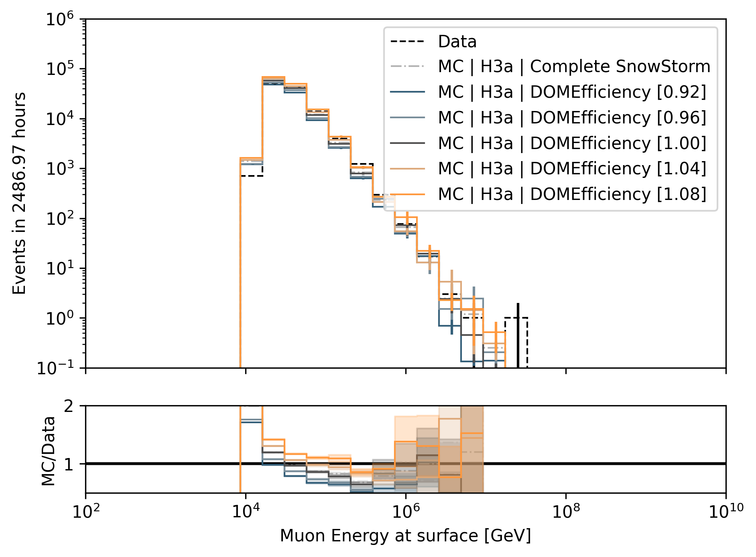
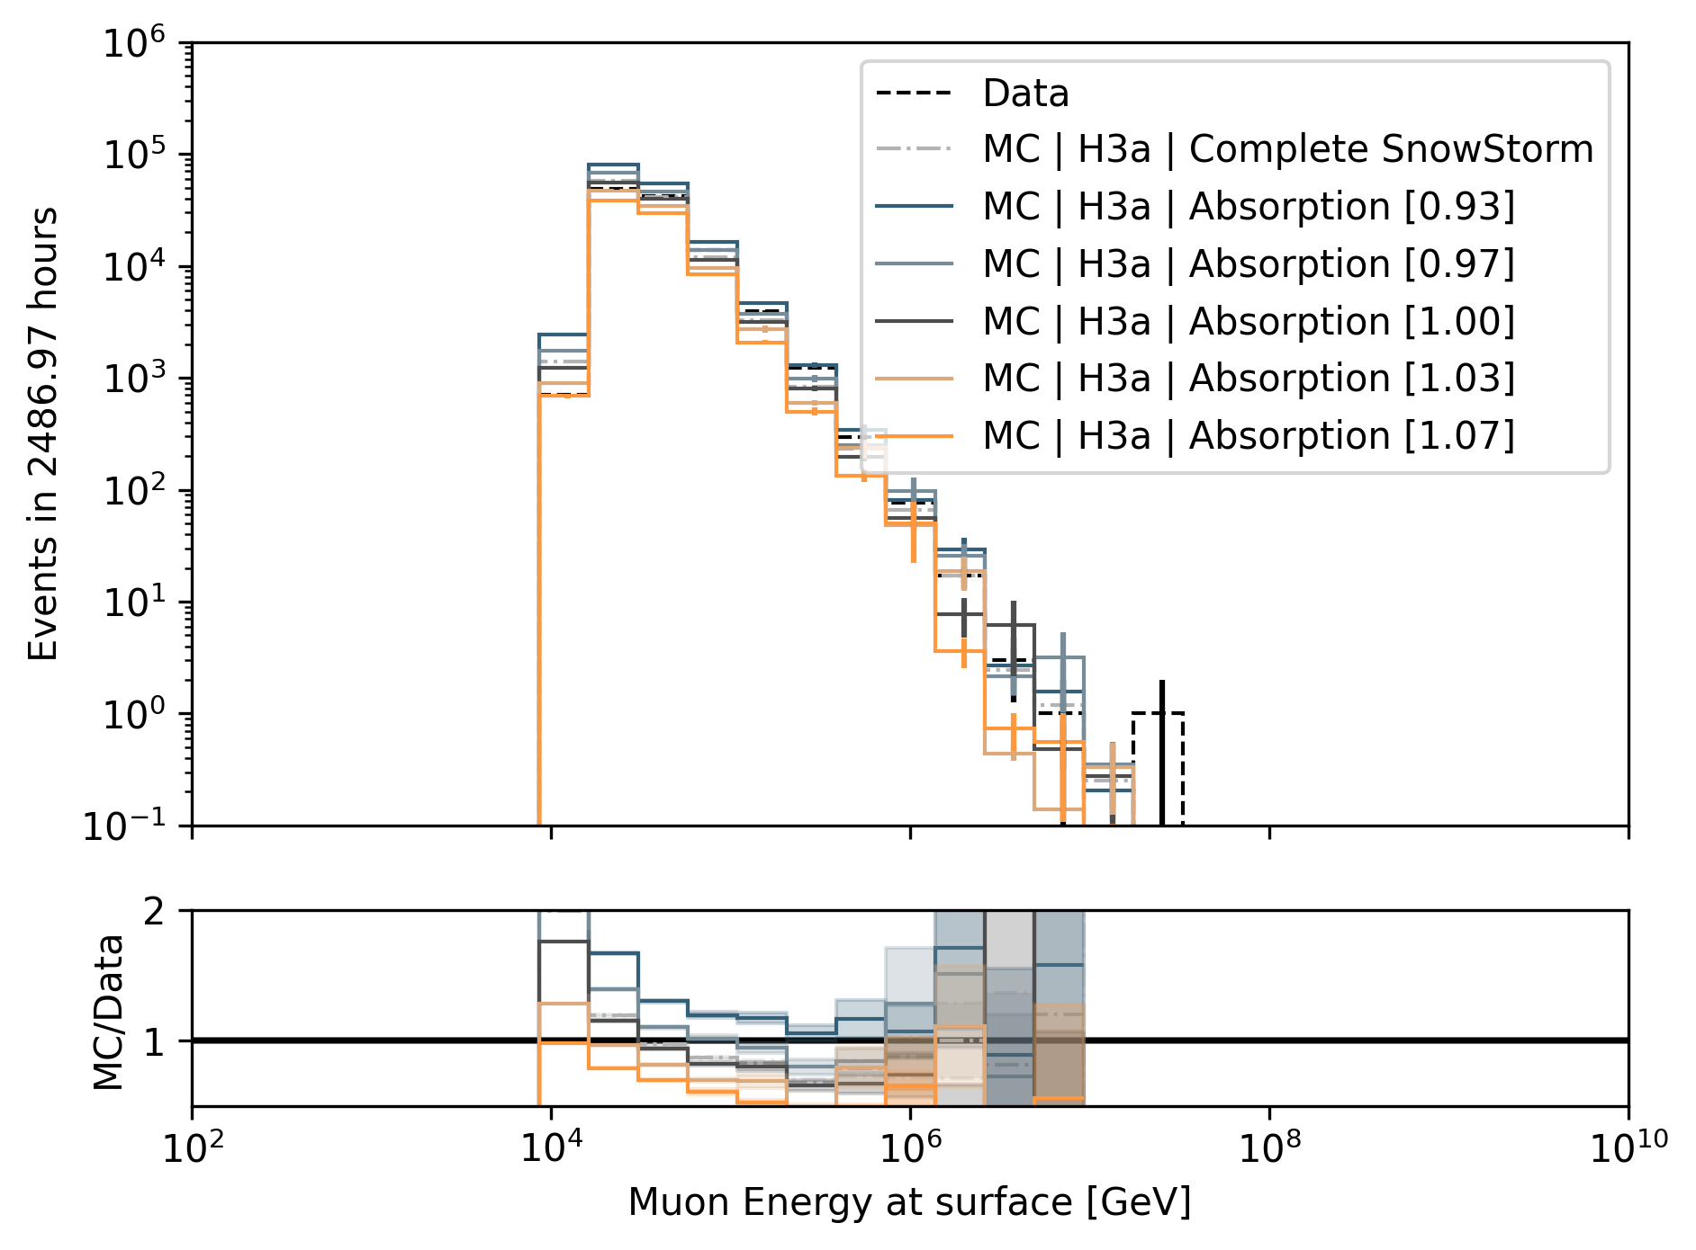
Systematics Impact on Muon Energy at Surface (Target)
HoleIce p0
Scattering
HoleIce p1
Divide systematic range into 5 equidistant bins
Largest impact by DOMEfficiency and Absorption
DOMEfficiency
Absorption

Slide 24
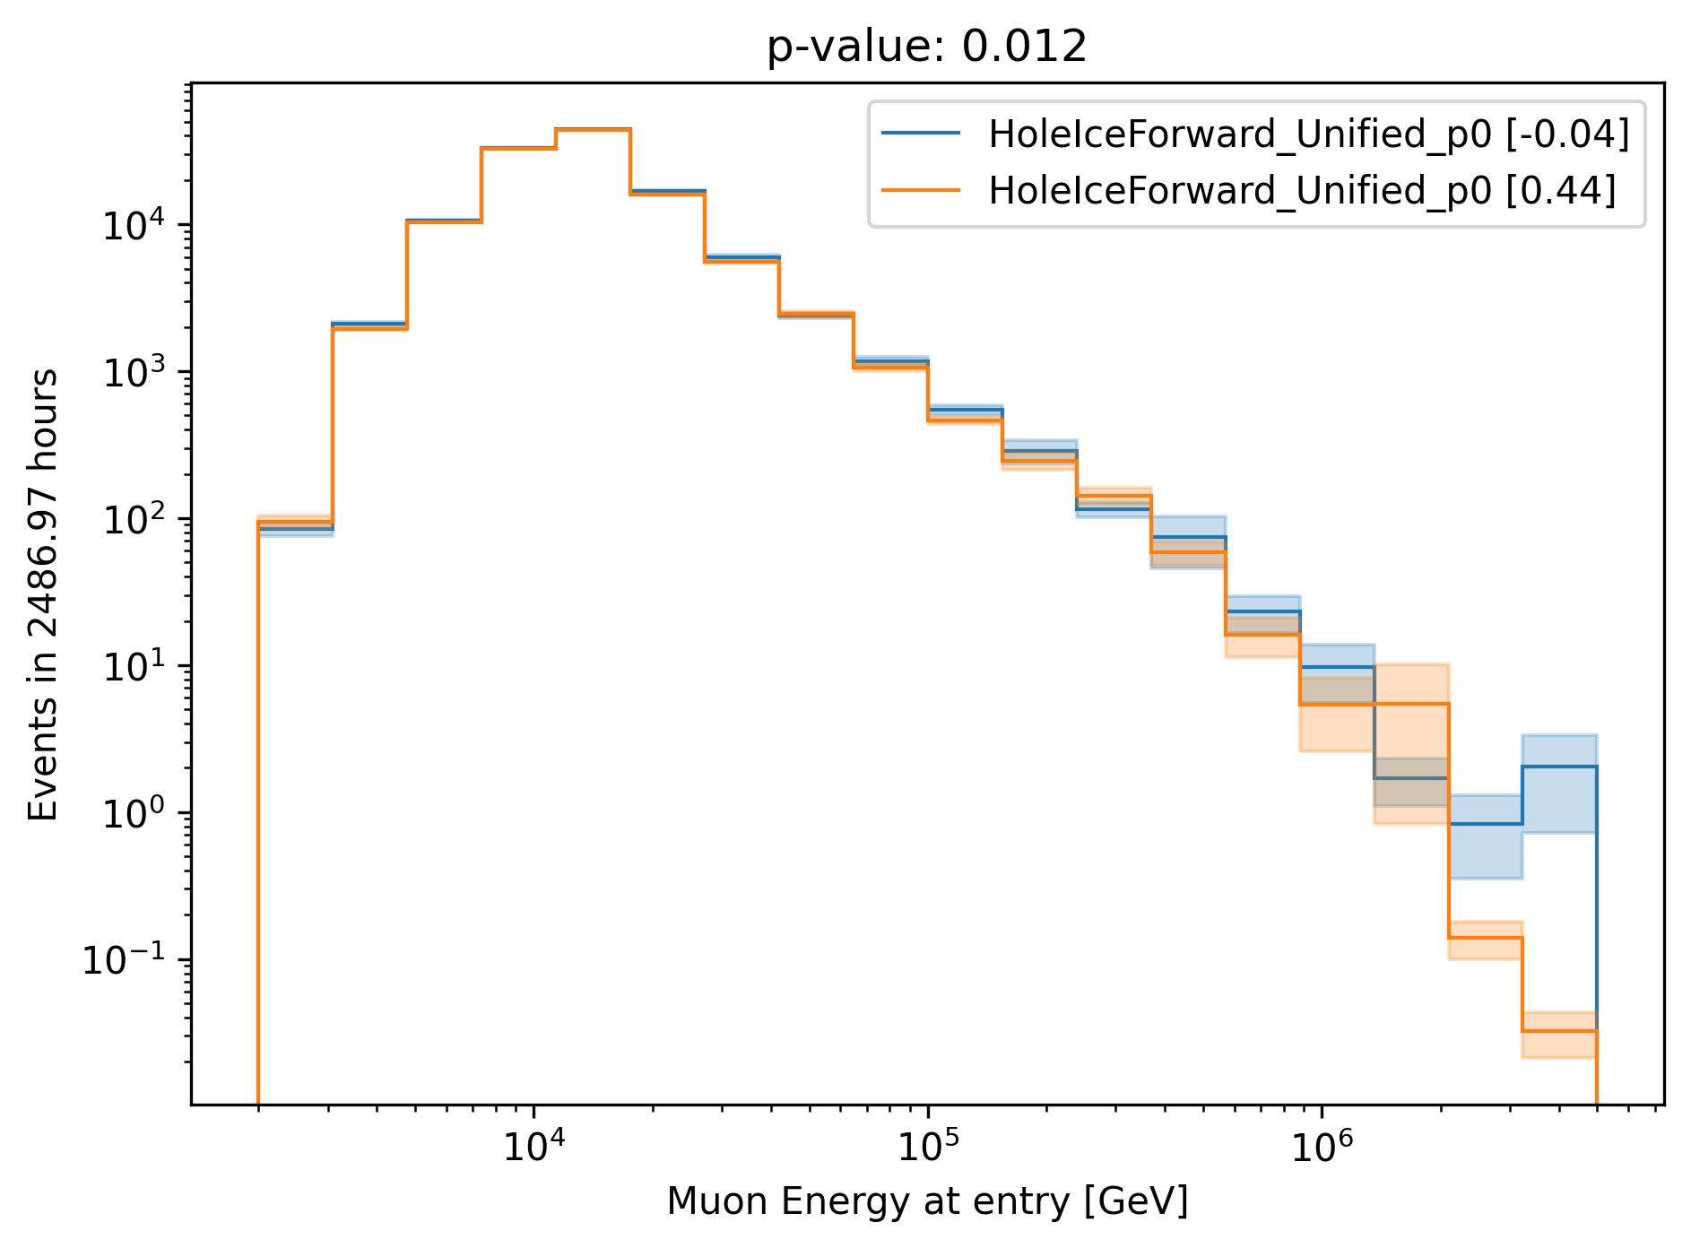
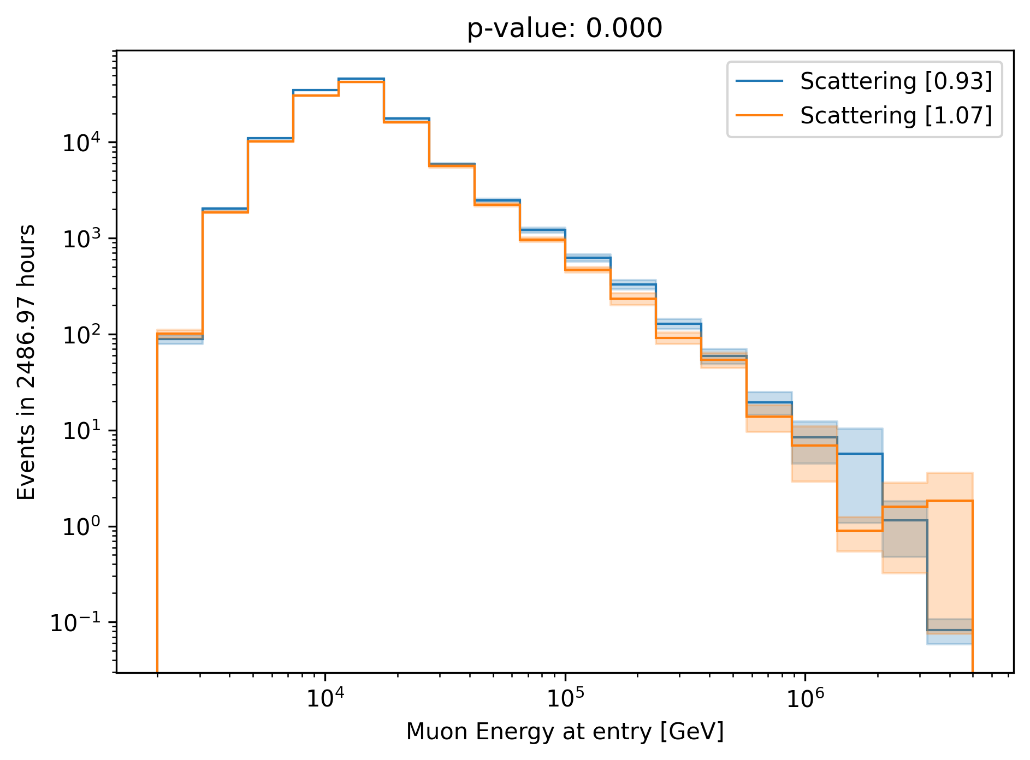
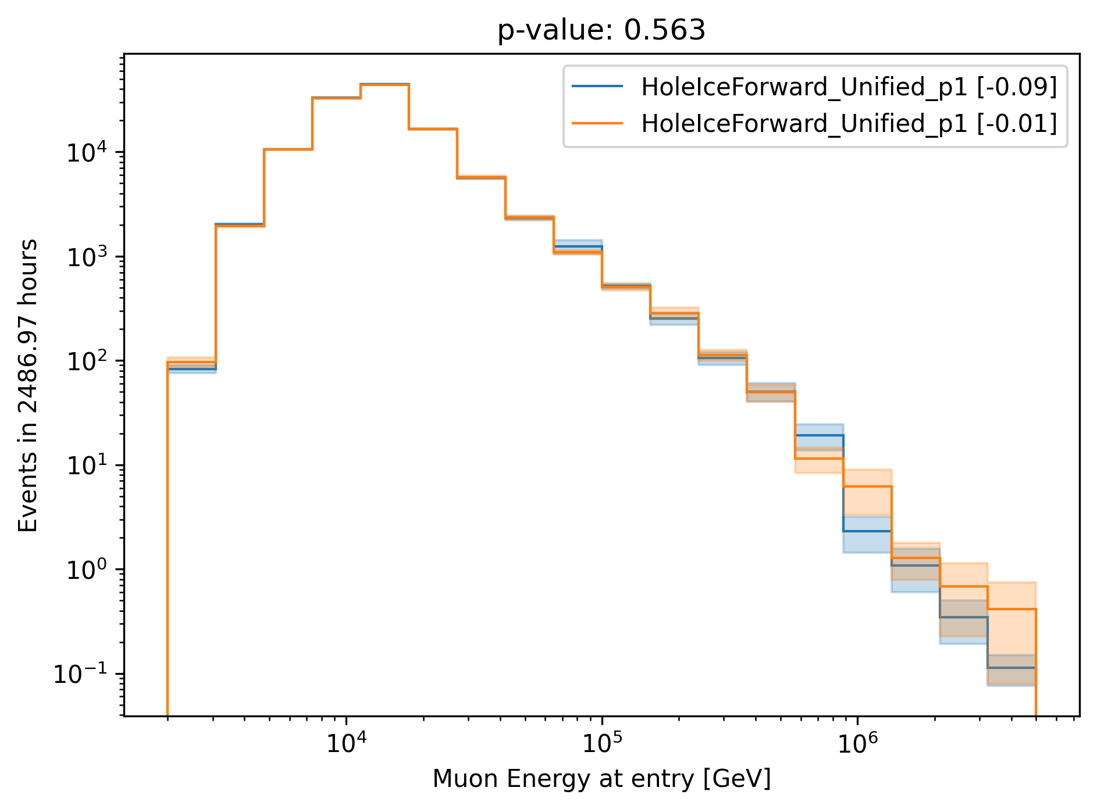
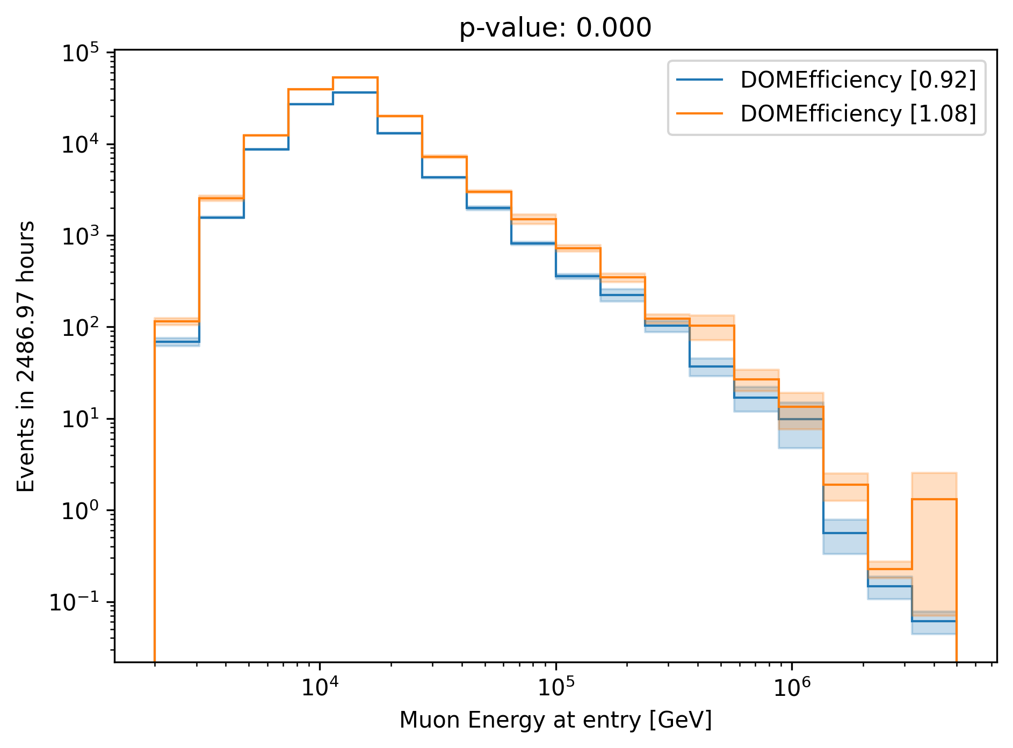
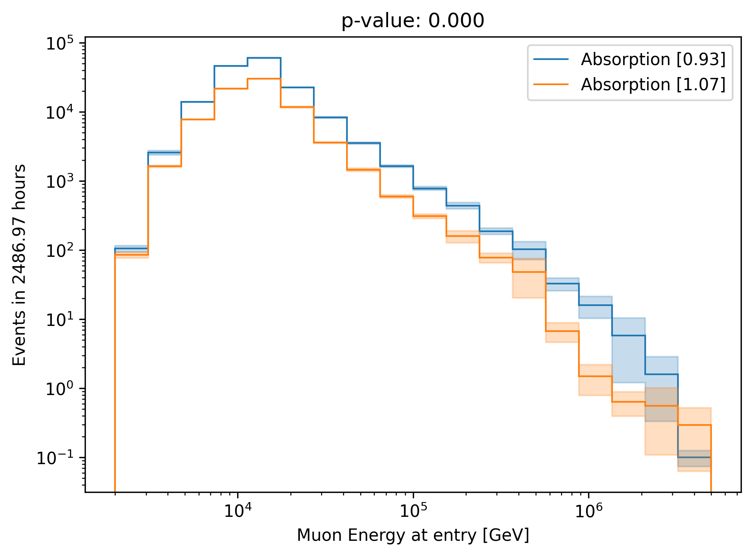
Chi2 Test: Muon Energy at Entry (Proxy)
HoleIce p0
Scattering
HoleIce p1
Chi2 test between lower and upper systematic range bin
No impact from Hole Ice p1
Small impact from Scattering and Hole Ice p0
DOMEfficiency
Absorption

Slide 25
Parameterize Systematics
Vary each systematic parameter for each proxy bin (18 proxy bins, 3 systematic bins)
Fit the relative change of the bin content
Chi2 test, if constant y = 1 is compatible with data points (p-value = 0.05)
Find linear fit with the lowest slope that is compatible with p-value = 0.2
Require fit is going through (center, 1)

Slide 26
Absorption

Slide 27
DOMEfficiency

Slide 28
Hole Ice p0 → not sensitive enough (same for Hole Ice p1)

Slide 29
Scattering

Slide 30
Unfold Muon Flux with Systematics
No regularization

Slide 31
Muon Flux at Surface (no regularization)

Slide 32
Unfold Muon Flux with Systematics
With regularization

Slide 33
Muon Flux at Surface (Tau = 0.001)

Slide 34
Systematic bins
Tau = None
Tau = 0.001
underflow bin
Regularization minimizes the correlation
Find tau with the minimum correlation
overflow bin

Slide 35
Conclusion
Unfold muon event rate ✅
Unfold muon flux at surface ✅
Parameterize ice systematics ✅
Small impact from Scattering, Hole Ice p0 , and Hole Ice p1
Linear parameterization of Absorption and DOMEfficiency
Unfold muon flux with systematics ✅
Next steps
Test impact of different primary models (spectral index)
Choose optimal regularization

Slide 36
Backup

Slide 37
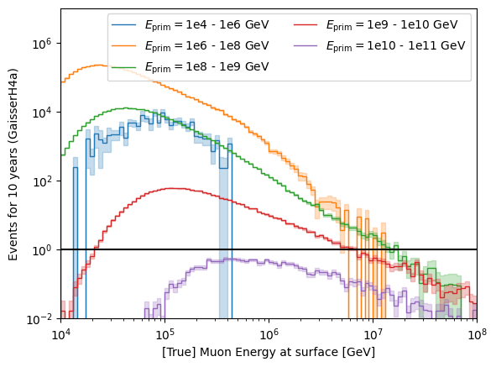
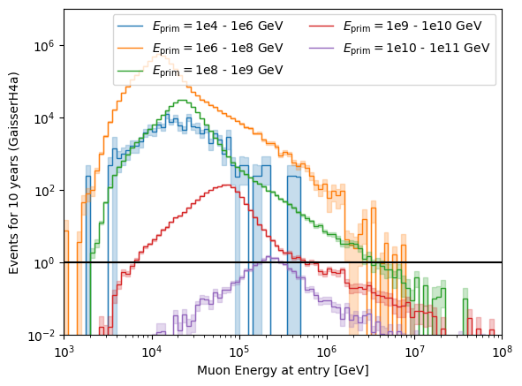
Relation between primary energy and muon energy at surface and entry

Slide 38
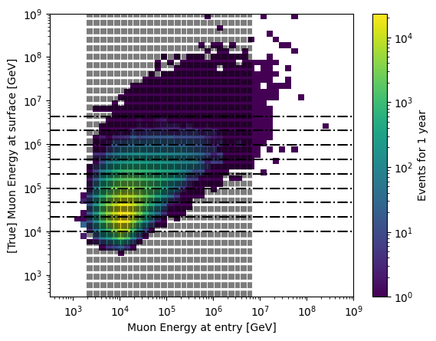
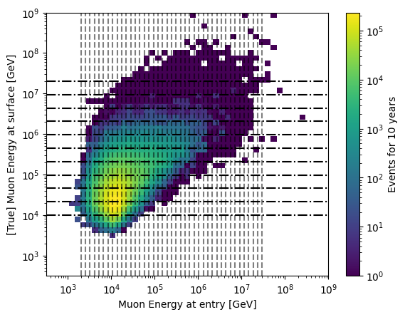
Proxy vs. target
1 year
10 years

Slide 39
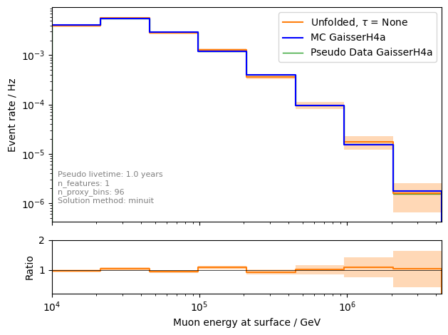
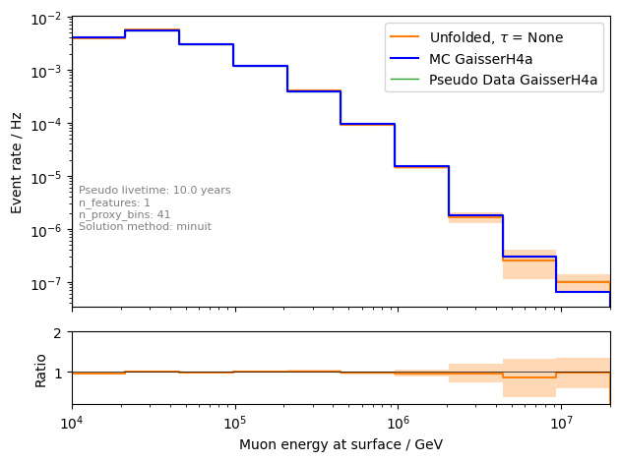
Unfolding event rate
1 year
10 years

Slide 40
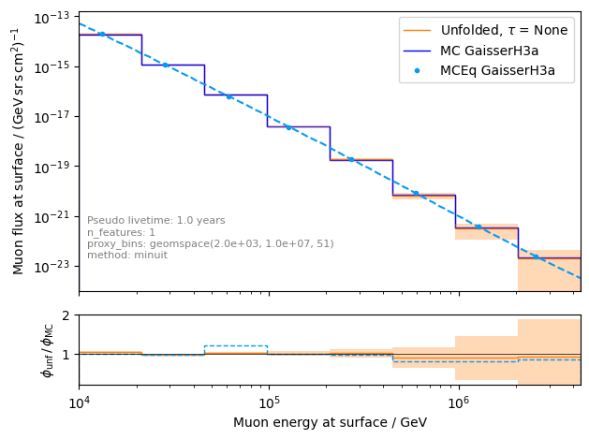
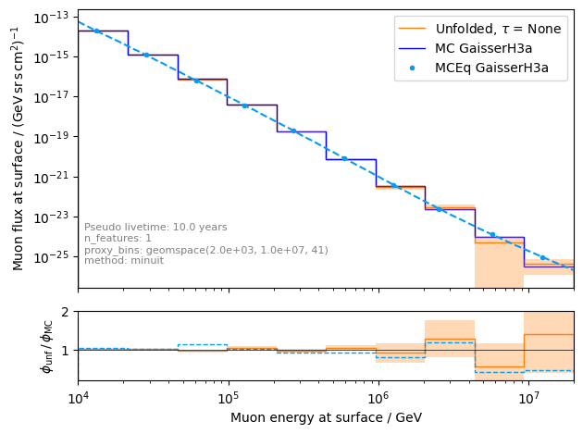
unfolding of muon flux at surface
1 year
10 years

Slide 41
Ice systematics
Snowstorm
Absorption
Scattering
DOMEfficiency
HoleIce 0
HoleIce 1

Slide 42
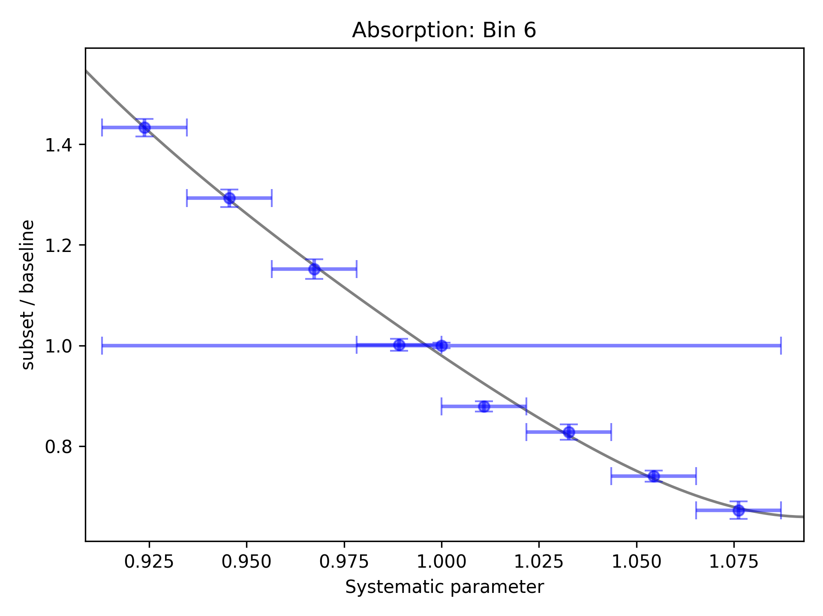




Fit ice systematics:
Parametrization for systematics in each proxy bin
Proxy: leading muon energy at entry
This is done for each systematic and every proxy bin

Slide 43



Unfolded event rate with systematics
work in progress
Use regularization to reduce unphyiscal oscillations

Slide 44

Conclusion & outlook
New CORSIKA simulations with parent information
tag prompt and conventional muons
validation: agreement with MCEq
Add DNN-based reconstructions
Good data-MC agreement
quality cuts defined
good agreement in cos(zenith) distributions
mismatch in z—position → re-weight distributions
Unfolding is set up
systematics can be included, minor investigations
Fit of prompt normalization is promising
systematics need to be included
How ChatGPT illustrates the detection of a prompt muon with IceCube.
Thank you for your attention!

Slide 45
Selection

Slide 46


level3: muon filter
HighQFilter: removes more horizontal events → muons travel large distances, not enough energy left to pass high-charge filter
Goal: keep AMAP high-energy events at surface → muon filter
Notes:
muon filter checks for number of hit channels and charge for 3 different zones onlineL2filter also checks for hit channels, charge and 3 zones, but also a couple of more properties like multiplicity, direct hits and specific shapes in the Qtot distribution (kinks, slope)

Slide 47


level3: 500 TeV bundle cut at surface
6 billion events expected: computationally not feasible → focus on high-energetic events
500 TeV cut: 6.7 Mio events left
use fast pre-cut network to estimate bundle energy at surface

Slide 48
Data-MC

Slide 49


Cos(zenith)

Slide 50


Entry position z—vertex

Slide 51

z—reweighting
re-weight events to enforce a perfect agreement in the center z—position

Slide 52


Check z—reweighting
re-weighting has no large effect on cos(zenith) and energy

Slide 53
Level5: quality cuts
containment cuts | > | <
length in detector | 1000 m | 2000 m
entry pos x, y | -750 m | 750 m
entry pos z | -500 m | 750 m
center pos x, y | -550 m | 550 m
center pos z | -650 m | 650 m
uncertainty cuts | <
bundle energy at entry | 0.9 log10(GeV)
bundle energy at surface | 2.0 log10(GeV)
zenith | 0.1 rad
azimuth | 0.2 rad
entry pos x , y, z | 42 m
center pos x, y, z | 50 m
entry pos time | 200 ns
center pos time | 600 ns
length in detector | 160 m
length | 2000 m
neutrino cuts | > | <
cos(zenith) | 0.2
length | 5000 m | 15000 m

Slide 54


Level5: quality cuts → removes neutrinos
network learns: a high-energetic horizontal event in the detector needs a very high energy at surface

Slide 55
Rates per month
Data-MC

Slide 56


Rates per month – Level 5
scaled on Level 4

Slide 57


Rates per month
before quality cuts
after quality cuts
total offset in rate per month

Slide 58

Rates per month: scaled
Rates are scaled to the experimental rate to compare the shapes
Good agreement per month

Slide 59


unfolding of muon flux at surface – weighted to E^{3.7}
1 year
10 years

Slide 60


Muon flux
Most energetic muon in bundle
Muon parent:
pion or kaon
yes
no
$φ_{tot}=φ_{prompt}+$ $φ_{conventional}$
conventional
prompt
Credit: Ludwig Neste
Notes:
gamma = 2.7: SNR → fermi/shock acceleration, propagation of cosmic rays lead to interactions with galactic magnetic fields, interactions with gas, energy losses (ionization and nuclear interactions), in this process, some cosmic rays can escape the magnetic fields → this rate is energy dependent → higher-energtic cosmic rays escape more quickly → steepening of spectrum to ~2.7

Slide 61

Prompt atmospheric muons and neutrinos
10.1103/PhysRevD.100.103018
no unflavored
dominated by pions
dominated by kaons
Combined fit:
handle on pion/kaon ratio
handle on charmed mesons

Slide 62

Leading muon energy fraction
Solid: conventional
Dashed: prompt
Prompt dominates for energies > 1 PeV
Leading energy sweet spot: 0.1 – 0.9

Slide 63


Leading muon contribution
Patrick Berghaus
Muons with energies between 100 TeV and 50 PeV dominate the bundle by more than 90%
In average conventional muons are more dominant than prompt
But: at high energies, there are more prompt than conventional events
High leading energy fraction does not lead to more sensitivity to detect prompt

Slide 64




Muon puzzle and hadronic uncertainties
”muon number”
Expected z
(“muon number”)
2012
2108.08341
1208.1520
Uncertainties at E > 10 PeV
2020
More muons measured than simulated for E > 40 PeV ~ cms 8 TeV
2006.05012

Slide 65

The Muon Puzzle
”muon number”
2108.08341

Slide 66

Possible Solutions
Hans Dembinski

Slide 67
Simulation w/o coincident events
for primary energies above 10 TeV, using a time window of 6 µs, the chance for a coincident event is ≤ 1 %

Slide 68
Bundle energy cut
Rate after muon filter: 24.62 Hz
If the process of 1 event needs 1 second, 8h run takes 200h -> needs to be reduced!
Use small, fast network to remove low energy events -> target rate 125 mHz
CPU runtime: 11 ± 1ms
GPU
Network: precut_surface_bundle_energy_3inputs_6ms_01

Slide 69
Leading muon energy fraction - leadingness
True muon energy fraction is smeared
Network tries to predict the median of the distribution

Slide 70
Bundle energy at entry – 6 µs cleaned pulses
Median + 90% quantile
Prediction
True

Slide 71
Leading muon energy at entry – 6 µs cleaned pulses
Median + 90% quantile
Prediction
True

Slide 72
Bundle energy at surface – 6 µs cleaned pulses
Median + 90% quantile
Prediction
True

Slide 73
Leading muon energy at surface – 6 µs cleaned pulses
Median + 90% quantile
Prediction
True

Slide 74
Zenith – 6 ms cleaned pulses
Median + 90% quantile
Prediction
True

Slide 75
Azimuth – 6 ms cleaned pulses
Median + 90% quantile
Prediction
True

Slide 76
SplineMPE – DNN and conventional seeds
SplitInIceDSTPulsesTWCleaning6000ns

Slide 77
SplineMPE – DNN seeds
SplitInIceDSTPulsesTWCleaning6000ns
DNN contours

Slide 78


Level5: cos(zenith)
Caution: weights are scaled

Slide 79

Level5: cos(zenith) – all primary models
Caution: weights are scaled

Slide 80


Proxy and target variable for unfolding – 10 years [H4a]

Slide 81

Unfolding with prompt and conv MCEq

Slide 82


Prompt and conv: muon energy at surface for 10 years

Slide 83


Compare all primary fluxes

Slide 84
Angular reconstructions: DNN vs. SplineMPE
DNN contours
DNN: ~6ms
Only small improvement at energies around 1 PeV
Countours are larger
Additional runtime
-> Use only DNN reconstruction, since we do not need the best angular resolution
Notes:
angular resolution: opening angle between true and reconstructed

Slide 85
Forward fit

Slide 86


Expected muons for 10 years: leading vs. bundle energy (GSF)
leading: energy of most energetic muon in a muon bundle
bundle: sum of energies of all muons of the bundle
L2 MuonFilter
L2 MuonFilter
Both leading and bundle energy are sensitive to detect prompt
Leading muon energy is more sensitive

Slide 87


Pseudo data sampling
Cuts:
L2 MuonFilter
Bundle energy at entry > 100 TeV
Tagging allows scaling of prompt by factor n_{pr}

Slide 88





Poisson likelihood fit performed in leading muon energy
Cuts:
L2 MuonFilter
Bundle energy at entry > 100 TeV
Test bias
Prompt scaling/normalization
MC counts per bin i
Conv norm = 1
Experimental counts
Maximize likelihood
With a constant conv norm:
bin counts depend only on prompt norm
= expectation value per bin
Easier:
minimize negative
log-likelihood
Test statistic for Wilks’ theorem
Bias starts at a prompt normalization of ~0.1
Null hypothesis: no prompt

Slide 89

Discovery potential and sensitivity
Cuts:
L2 MuonFilter
Bundle energy at entry > 100 TeV
Expectation for 1 year:
5 sigma discovery potential: 0.102 ± 0.005
Sensitivity: 0.024 ± 0.001
Expectation for 10 years:
5 sigma discovery potential: 0.032 ± 0.001
Sensitivity: 0.007 ± 0.000
Caution:
Limited MC statistics -> events are oversampled in pseudo dataset
No systematic uncertainties

Slide 90
Input data per DOM
10.1088/1748-0221/16/07/P07041
3 inputs
c_{total}: Total charge
Sum of charge
t_{first}: Relative time of first pulse
Relative to total time offset, calculated as the charge weighted mean time of all pulses
t_{std}: Standard deviation of first pulse
Charge weighted standard deviation of pulse times relative to total time offset
9 inputs
t_{last}: Relative time of last pulse
Relative to total time offset, calculated as the charge weighted mean time of all pulses
t_{20%}: Relative time of 20% charge
Relative to total time offset, calculated as the charge weighted mean time of all pulses
t_{50%}: Relative time of 50% charge
Relative to total time offset, calculated as the charge weighted mean time of all pulses
t_{mean}: Mean time
Charge weighted mean time of all pulses relative to total time offset
c_{500ns}: Charge at 500ns
Sum of charge after 500ns
c_{100ns}: Charge at 100ns
Sum of charge after 100ns
Input pulses
SplitInIceDSTPulses
SplitInIceDSTPulsesTWCleaning6000ns
(DNN framework performs an internal cleaning)
Training datasets
20904
21962
22020
22187

Slide 91




Air shower – 10 TeV
“muon bundles”
zeuthen.desy.de
Ralph Engel 2005
2211.16970v2
Proton
Iron
Notes:
shower maximum: x_max, slant depth at which the number of particles is the greatest, more energetic and lighter cosmic rays produce deeper/lower x_max, while heavier nuclei have a higher shower maximum
measure number of particles / muons
lateral spread
nitrogen can be excited → fluorescence light emitted
iron produces more muons than proton, because it has 56 nucleons → higher fragmentation → “sub-showers”

Slide 92
Agreement for different primary models

Slide 93


Azimuth

Slide 94


Bundle energy at entry

Slide 95


Leading muon energy at entry

Slide 96


Entry position x–vertex

Slide 97


Entry position y–vertex

Slide 98
DNN reconstructions

Slide 99
Reconstructed properties
Energy
entry_energy: Leading muon energy at the detector entry
bundle_energy_at_entry: Muon bundle energy at the detector entry
muon_energy_first_mctree: Leading muon energy at surface
bundle_energy_in_mctree: Muon bundle energy at surface
Track geometry
Length: Propagation length of muon in the ice
LengthInDetector: Propagation length of muon in the detector
center_pos_x: Closest x position of muon to center of the detector
center_pos_y: Closest y position of muon to center of the detector
center_pos_z: Closest z position of muon to center of the detector
center_pos_t: Time of closest approach to the center of the detector
entry_pos_x: x position of muon at the detector entry
entry_pos_y: y position of muon at the detector entry
entry_pos_z: z position of muon at the detector entry
entry_pos_t: Time of muon at the detector entry
Direction
zenith: Zenith angle of muon
azimuth: Azimuth angle of muon
Network 1
Network 0: Muon bundle energy at surface (fast pre-cut)
Network 2
Network 3

Slide 100


Muon flux: Prompt spectrum
$φ_{tot}=φ_{prompt}+$ $φ_{conventional}$
0°: perpendicular to Earth’s surface
Most energetic muon in bundle
conventional
prompt
Muon parent:
pion or kaon
yes
no
conventional
prompt

Slide 101


Neutrino: z-vertex
Dissertation Mirco
Same shape mismatch for neutrinos as for muons

Slide 102
Stopping muons

Slide 103




Entry position z - different cos(zenith)

Slide 104




Entry position z - different cuts on bundle energy at surface

Slide 105
New CORSIKA simulation
with extended history option for information about the parent particles

Slide 106
CORSIKA 7 tagging and MCEq comparison
MCEq: tool to numerically solve the cascade equations that describes the evolution of particle densities as they propagate through a gaseous, dense medium
https://github.com/mceq-project/MCEq
GSF weighting
GSF weighting
Good agreement in total prompt and conv muon flux
D⁰ and D_{s} are swapped here but this is fixed in MCEq

Slide 107


Astroparticle physics
gallery.icecube.wisc.edu
Credit: IceCube / NSF

Slide 108

Cosmic ray flux
1903.07713
Notes:
1. Knee: ~3 PeV, before gamma = 2.7, limit of acceleration mechanism for cosmic rays in supernova remnants 2. Knee: ~100 PeV, before gamma = 3.1, heavier elements, like iron, from galactic sources start to reach their maximum acceleration energy → more protons, larger energy in electromagnetic acceleration Ankle: ~1 EeV, flattens out again, transition point between galactic and extra galactic particle origin,

Slide 109

Reconstruction of leading muon at entry (99% quantiles)

